Slide 1
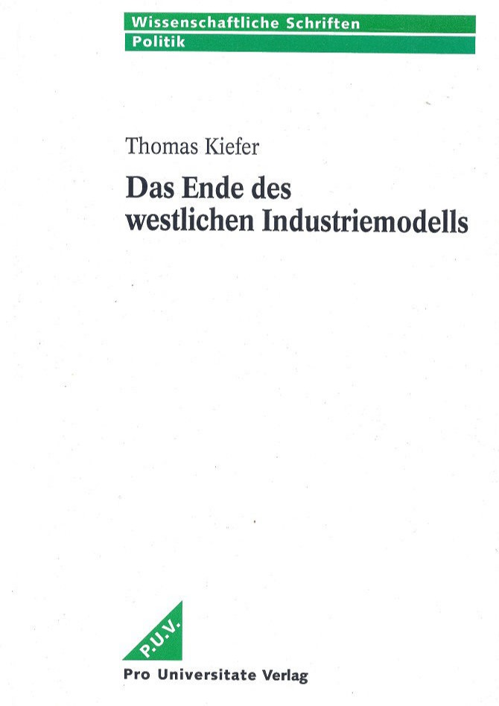

China's automotive industry
The end of the Western industrial model

Slide 2
Studies from 1988 onwards in China, Asia and America
China's production capacity is sufficient to handle global output.
However, the devastating consequences of climate change were already becoming apparent at that time.
Furthermore, fossil resources, specifically oil, are limited and unstable.
Huge amounts of foreign currency are needed to import cars and oil.
Building a domestic automotive industry is necessary.
Latest technology and skilled workers are needed.
Goal: clean production systems.
However, China's electric transport is predominantly rail-based – high-speed trains – commuter rail systems.
http://projekte-international.de/Publikationen

Slide 3
Foreign competition forces existing industries to modernize
In return, foreign companies gain market access and billions in profits.
However, half of the profits go to the Chinese joint venture partners.
This made both sides complacent.
A market economy thrives on competition.
Competition leads to innovation and lower prices.
However, competition can be destructive.
A coordinated government plan is necessary.

Slide 4
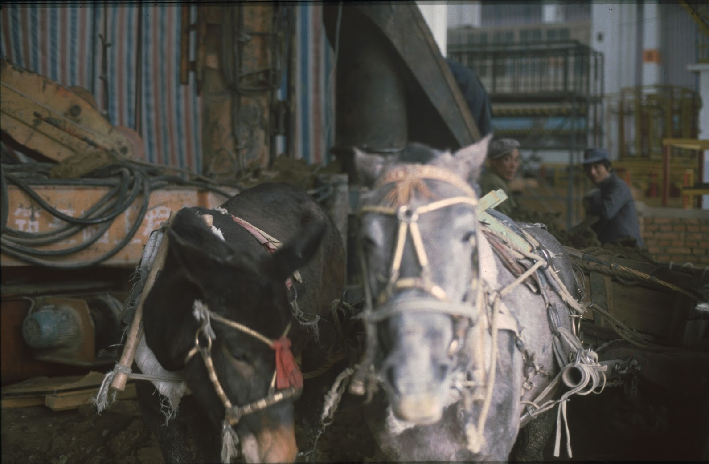
From donkey cart to smart electric car
FAW – industrial colossus modeled on the Soviet Union.
VW’s second joint venture.
"Socialist market economy“.
Pooling energy with competitors, competing in the market.
Photo: construction of the FAW-VW plant – utilizing existing resources.

Slide 5
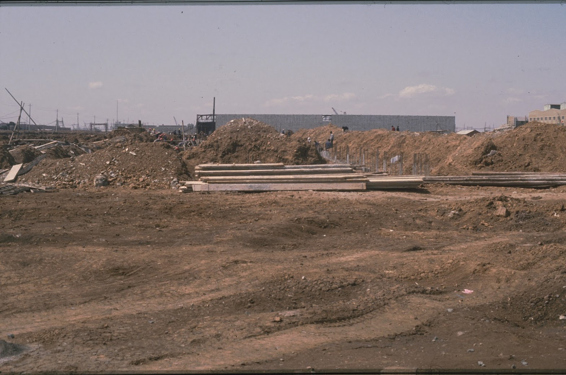
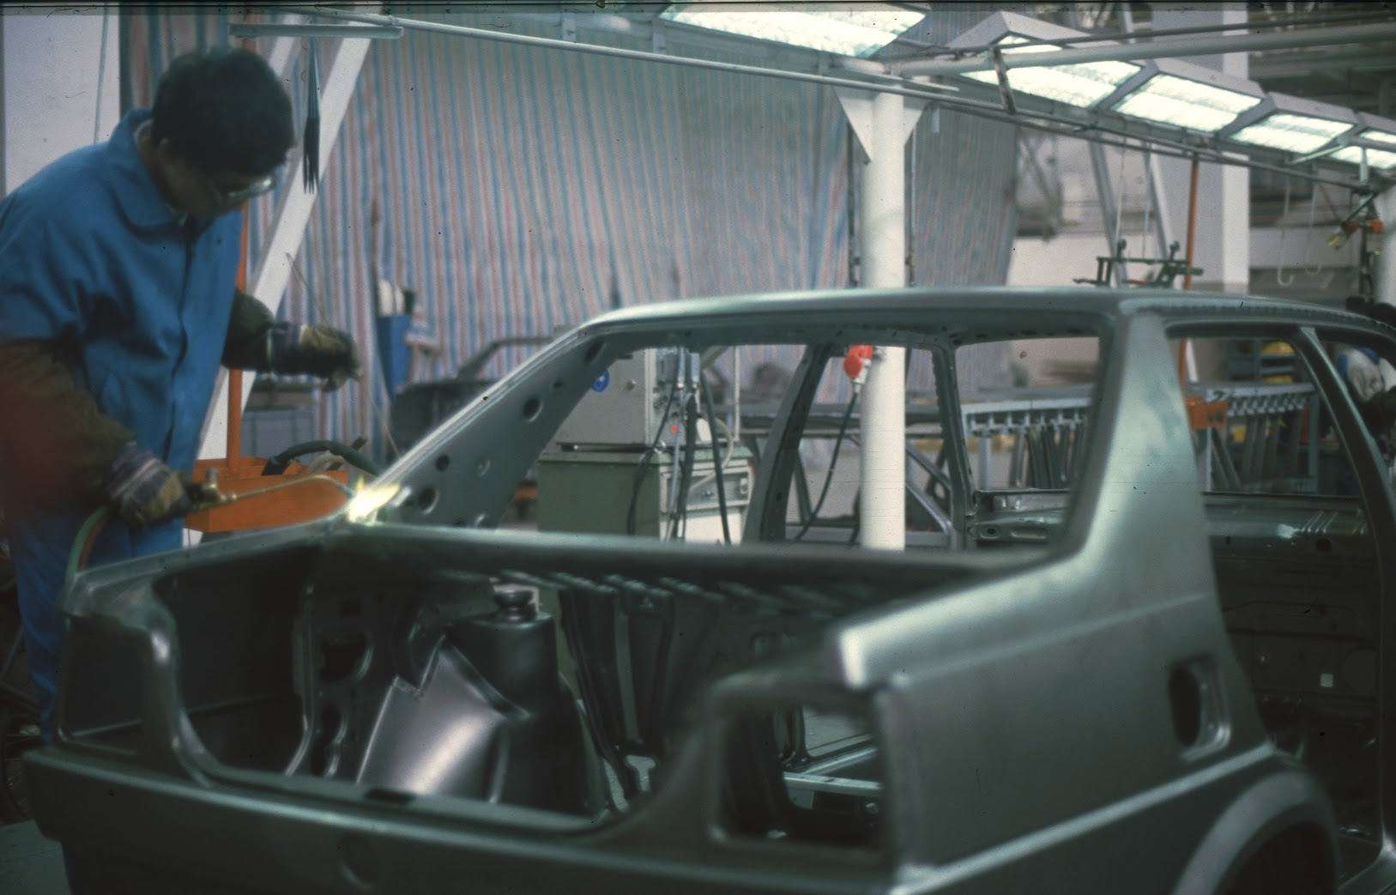
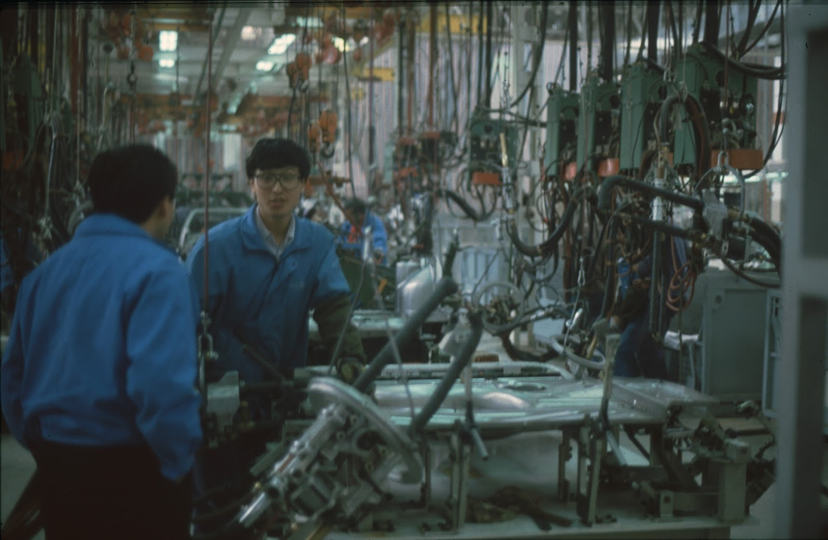
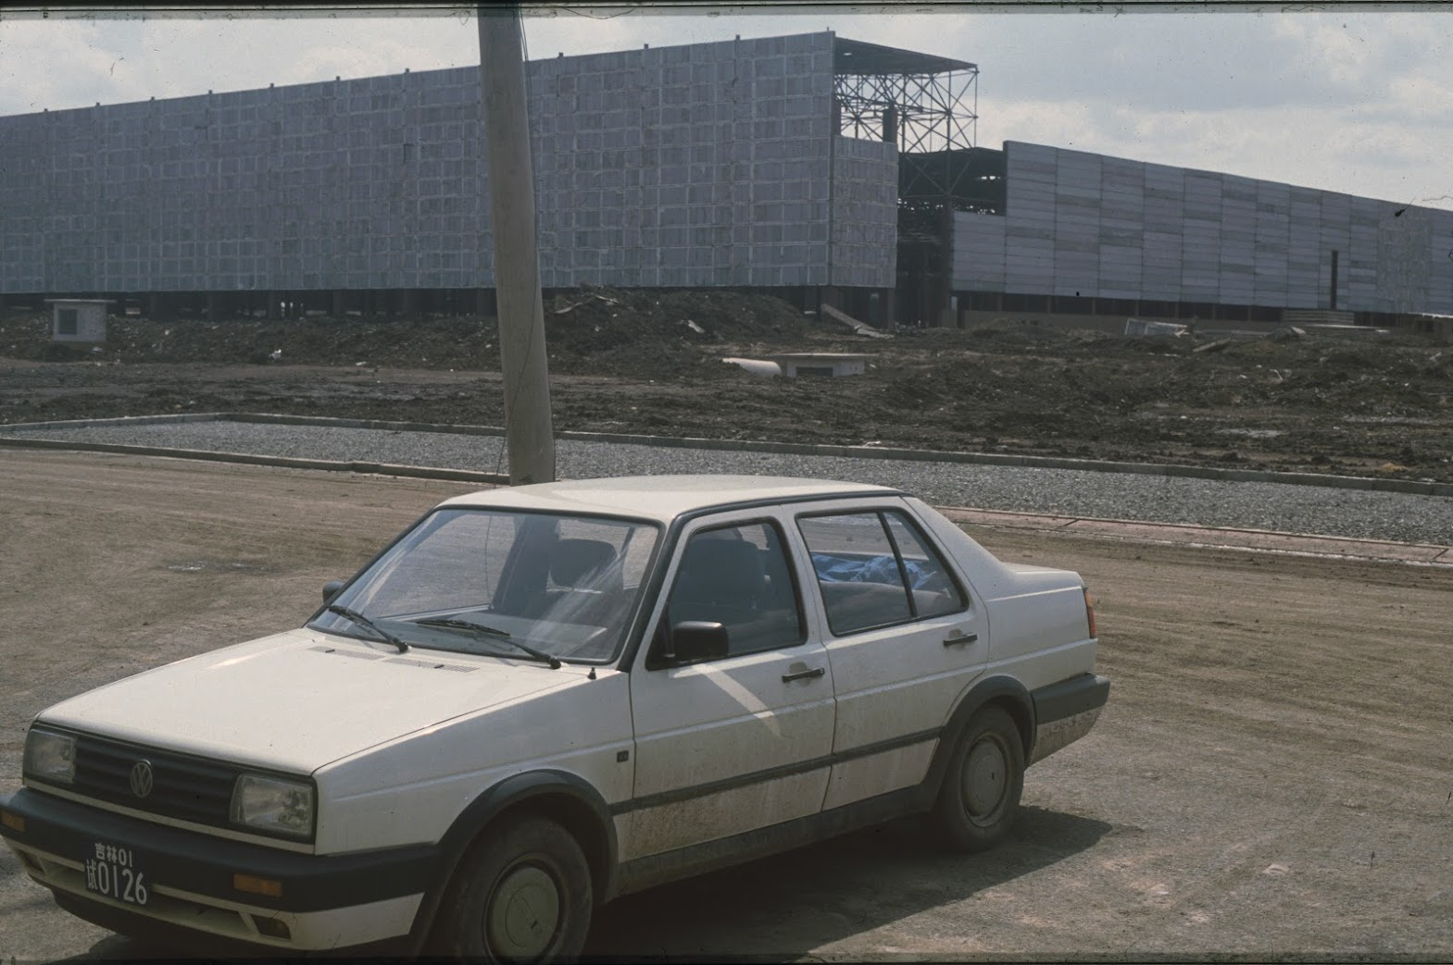

Slide 6
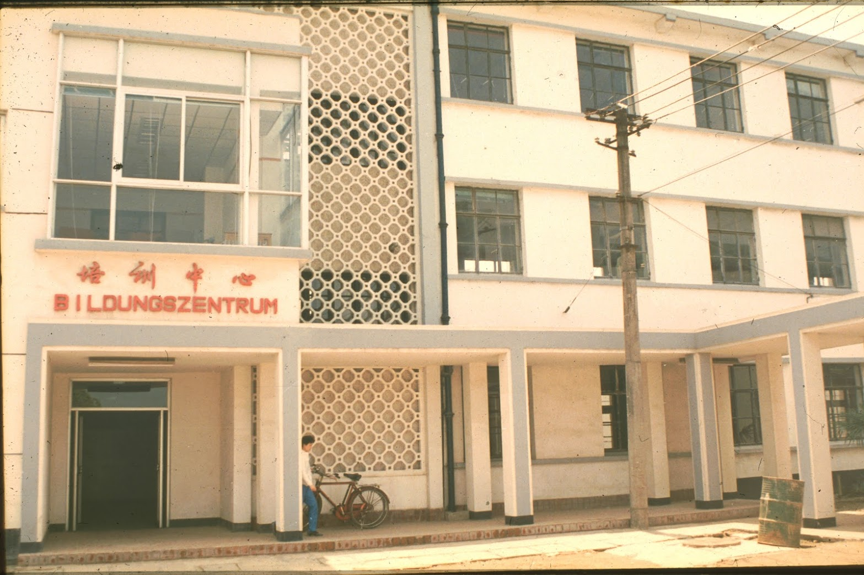
Shanghai Volkswagen
Volkswagen in Germany is also state-controlled by the government.
Trade unions have significant influence.
Unlike other corporations, Volkswagen is willing to
invest in education and the latest technologies.

Slide 7
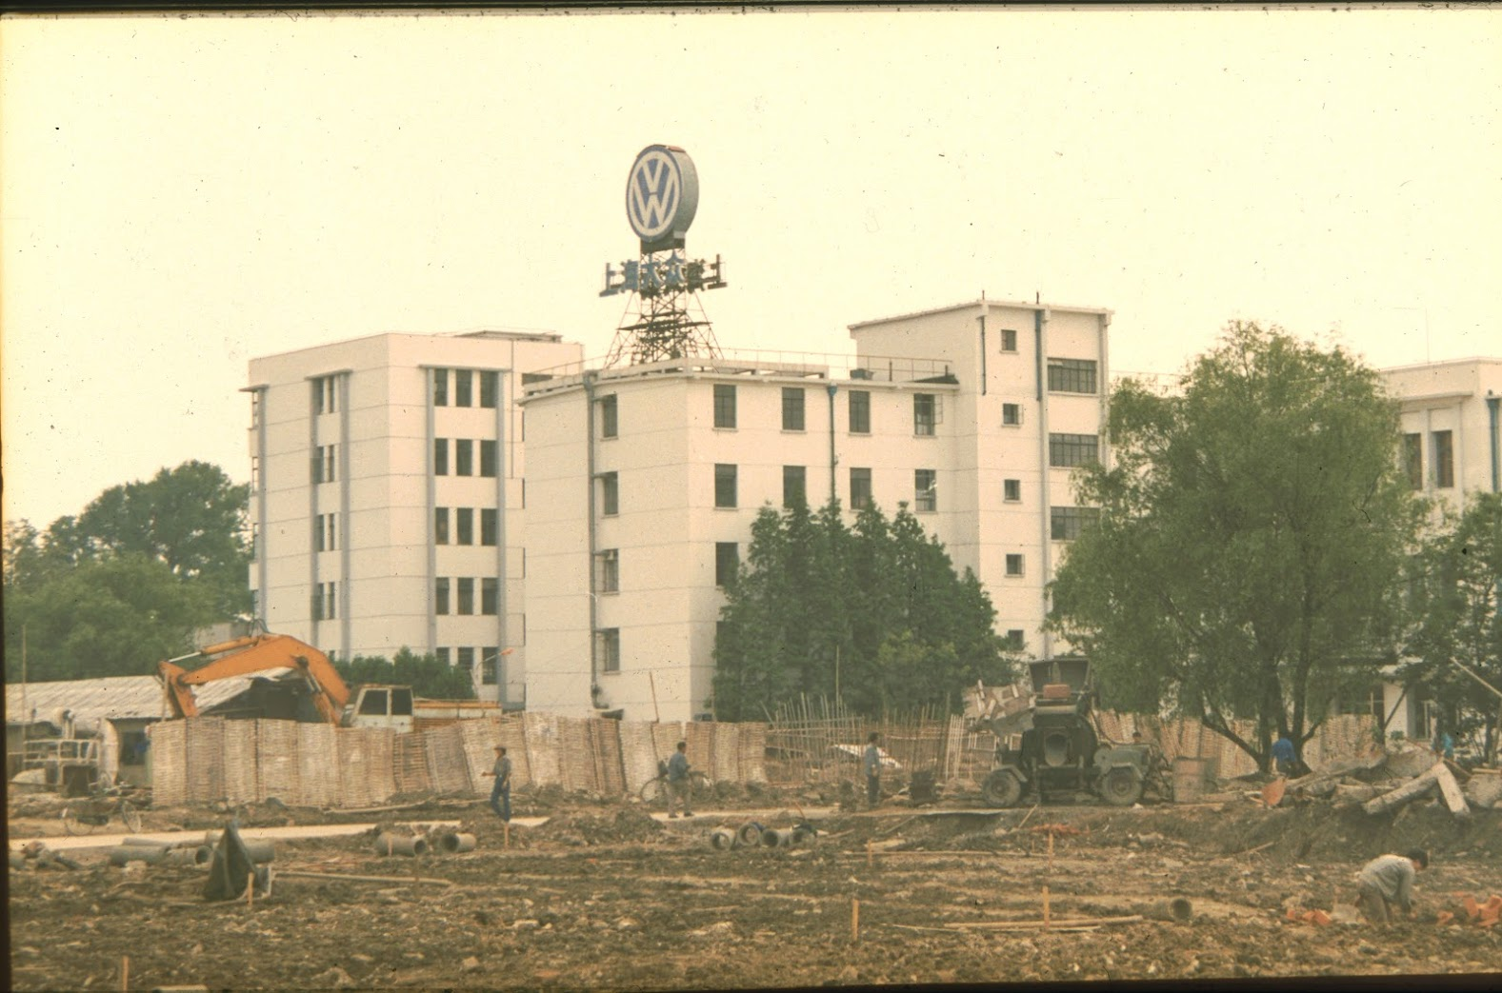
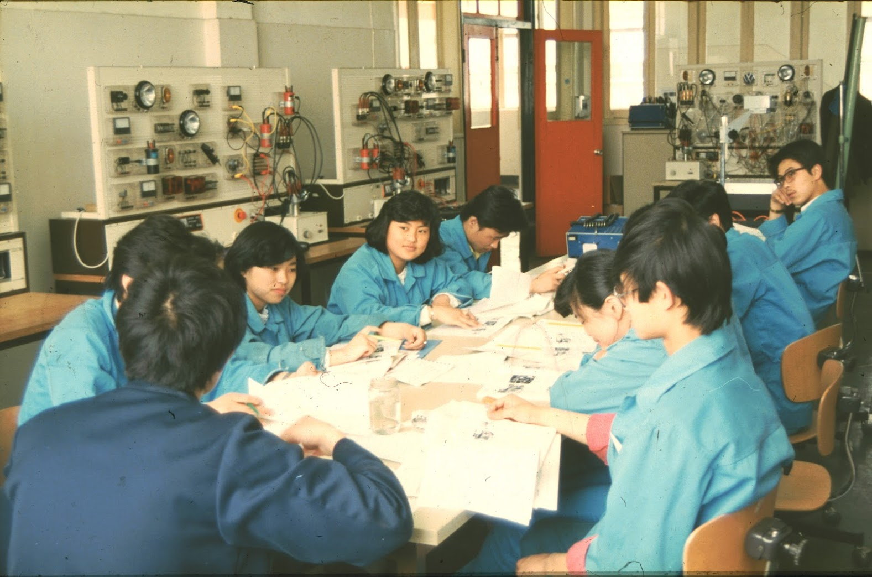
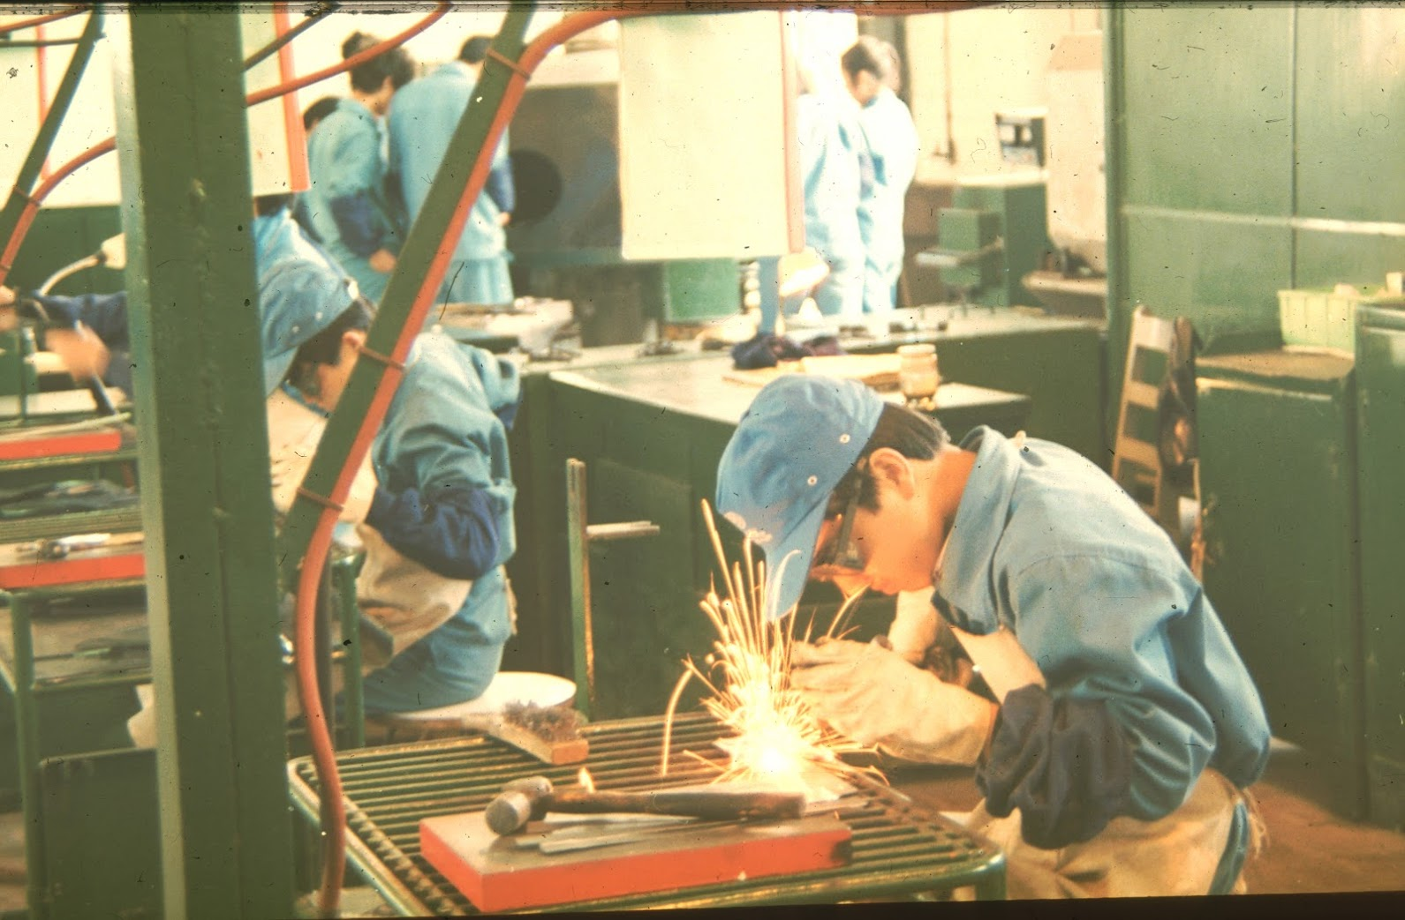
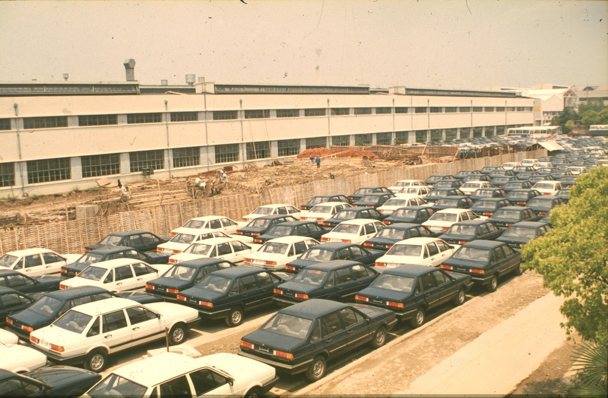

Slide 8
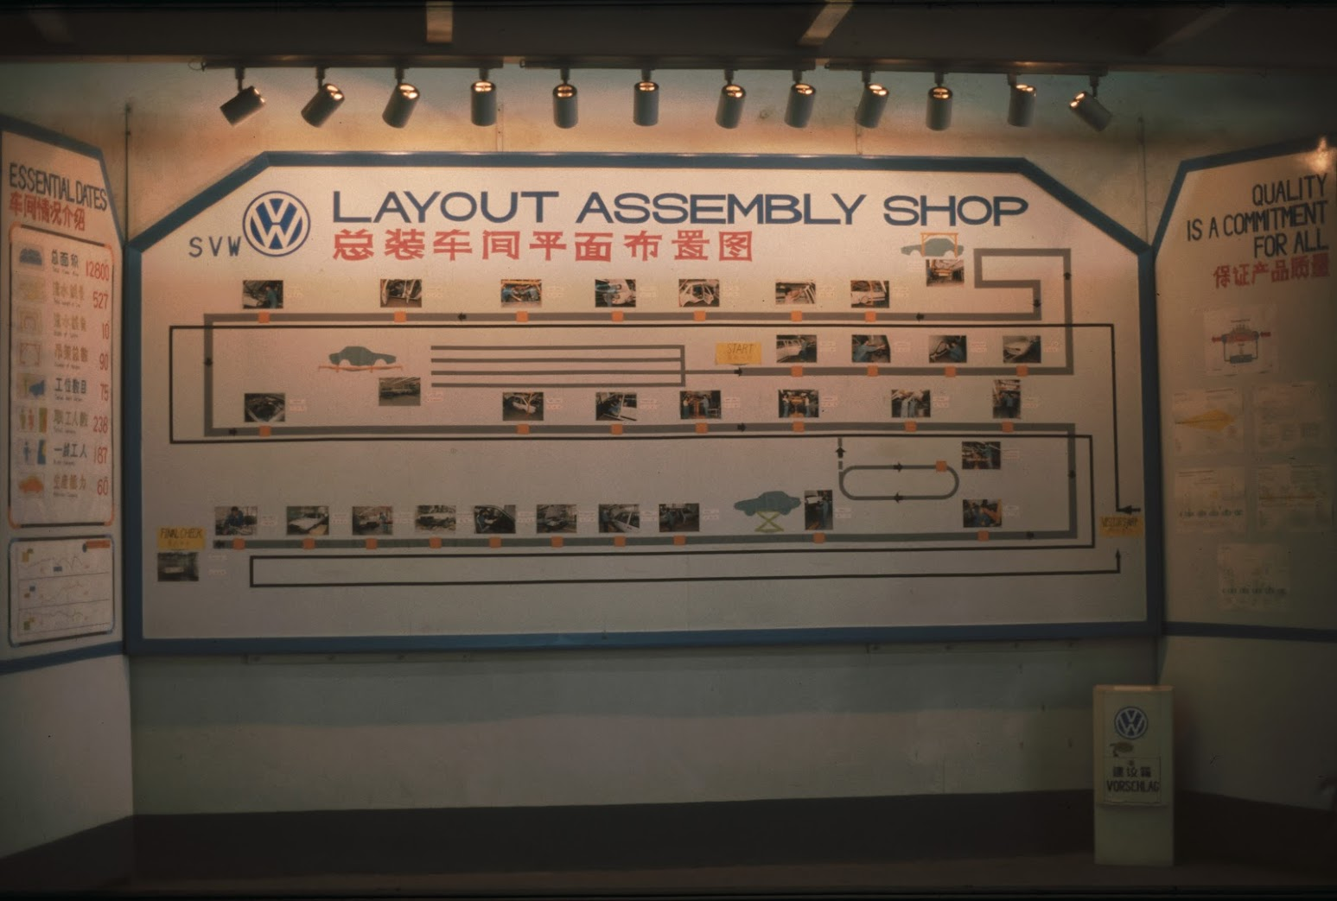
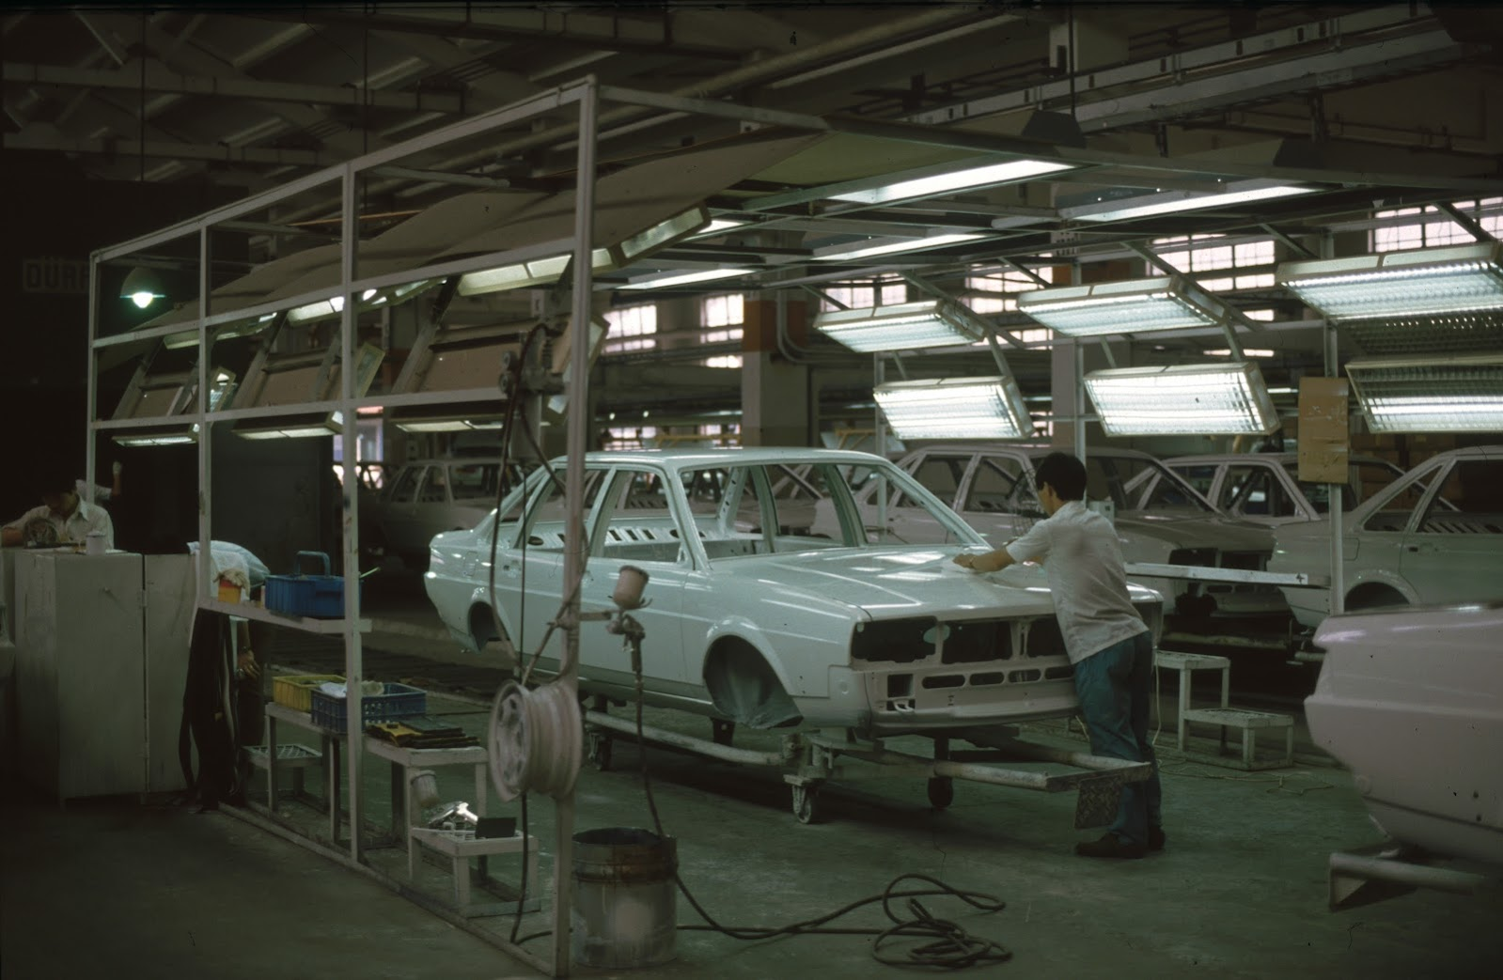
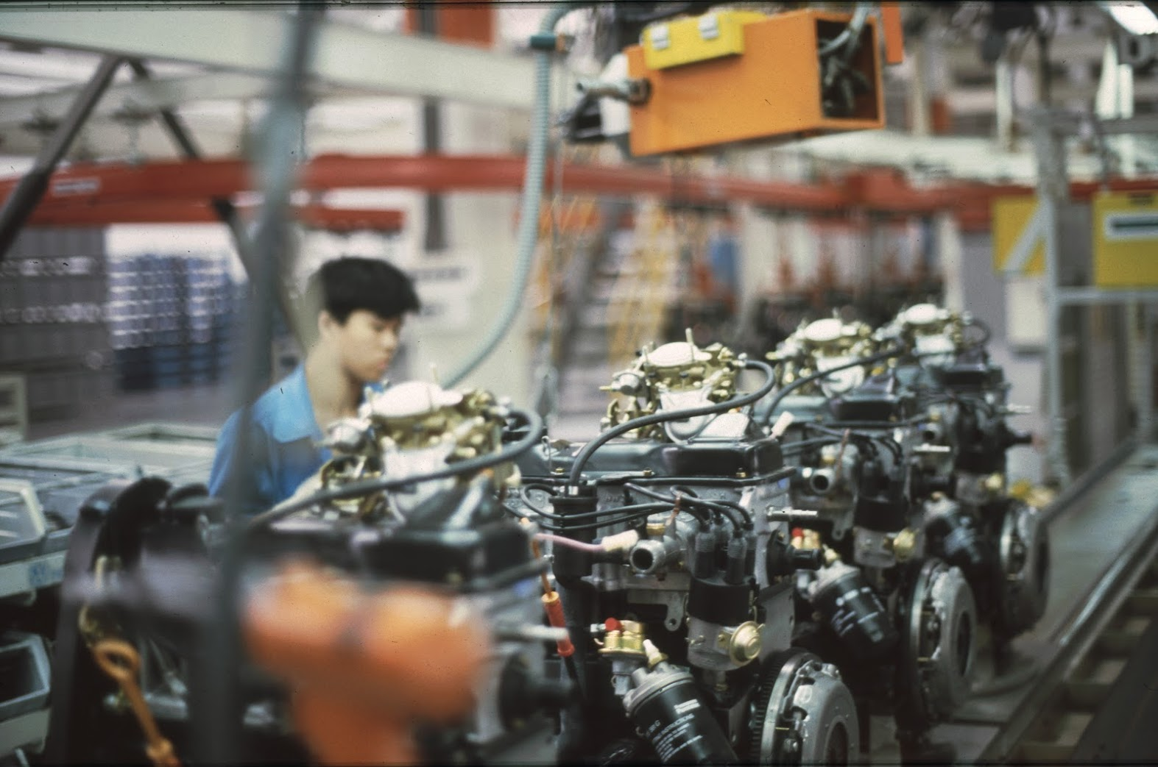
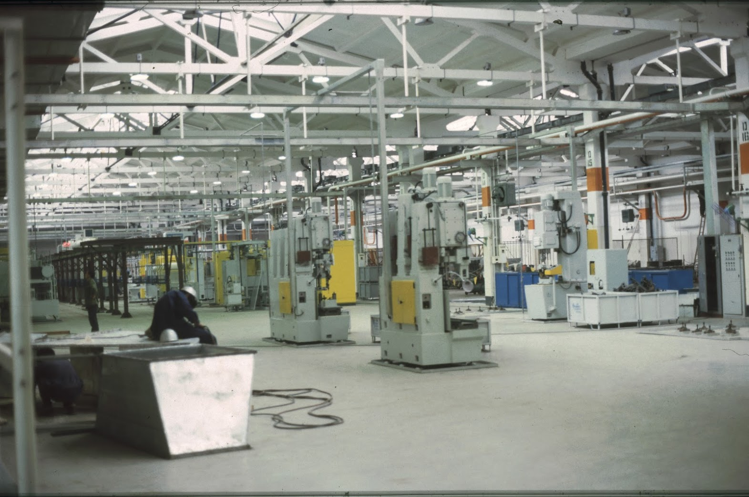

Slide 9
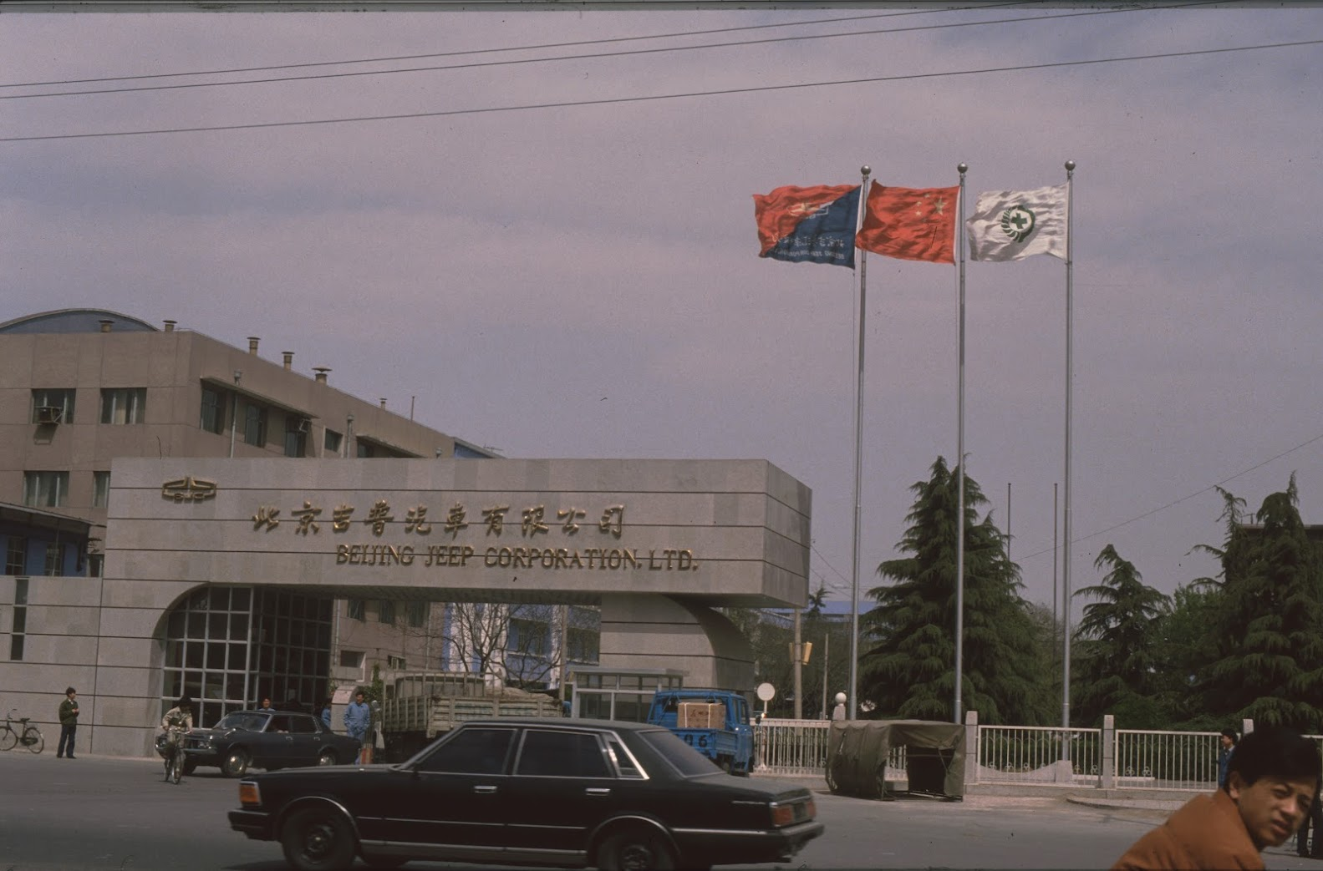
Beijing Jeep Corporation
Beijing Jeep Corporation was a joint venture between AMC and BAW. AMC was acquired by Chrysler in 1987, which merged with Daimler-Benz in 1998. Beijing Jeep Corporation became Beijing Benz-DaimlerChrysler Automotive Co., Ltd. in 2005.
Little technology transfer.
Contrasting management cultures.

Slide 10
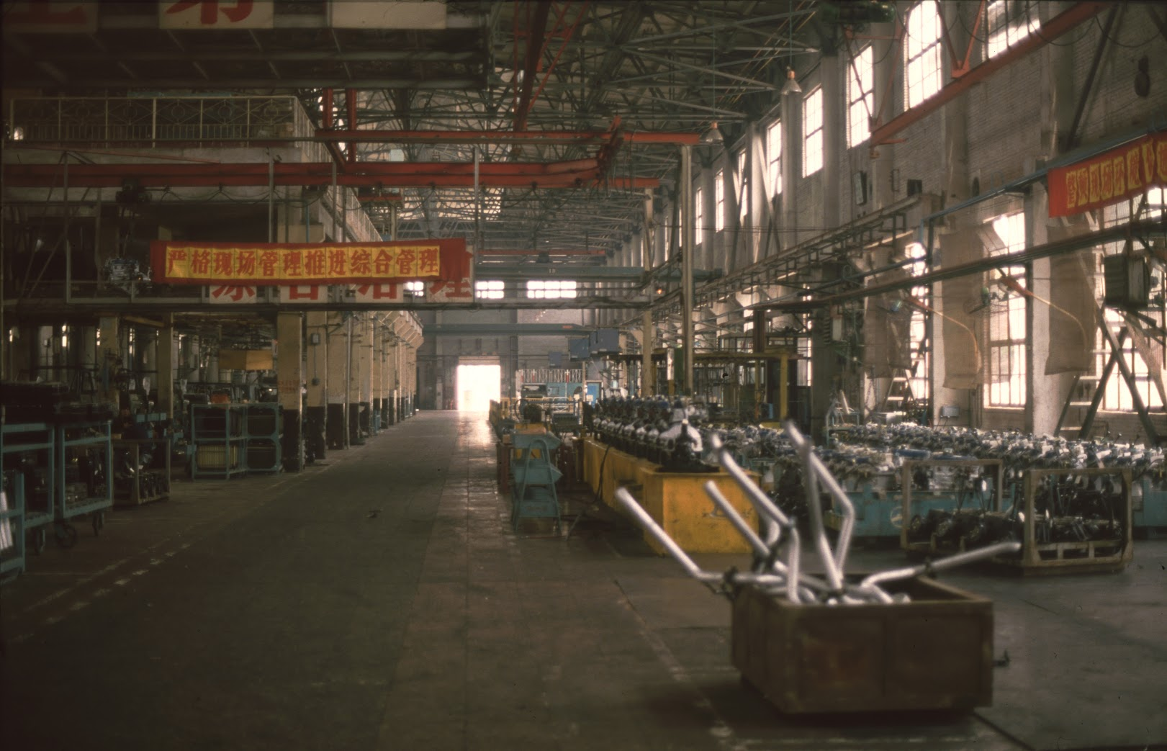
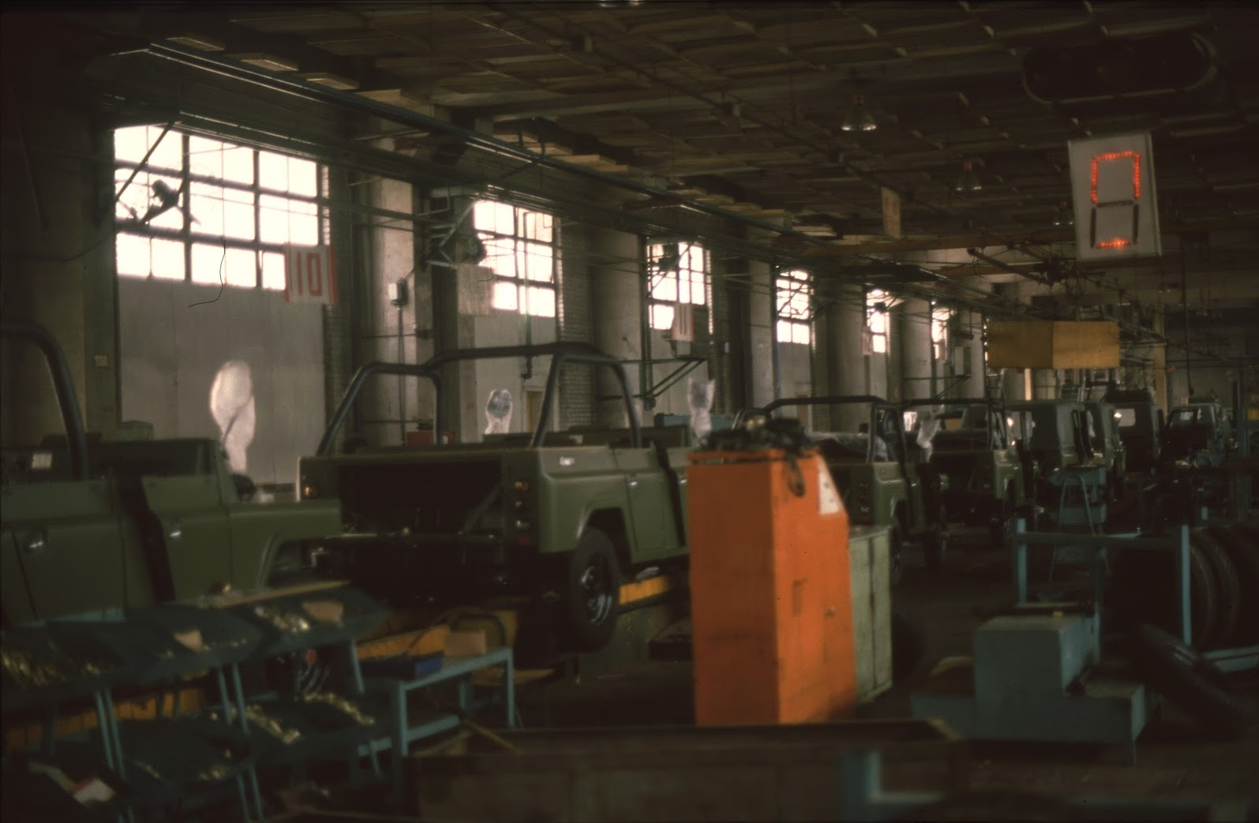
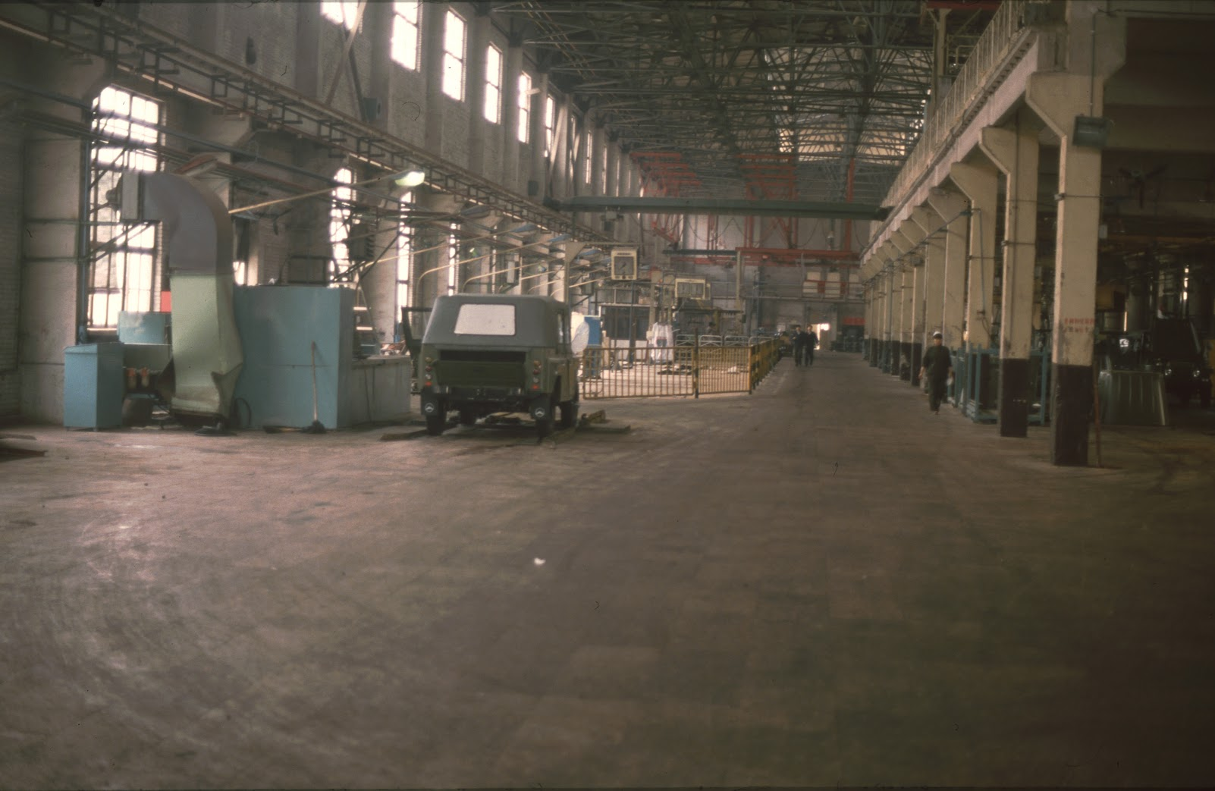
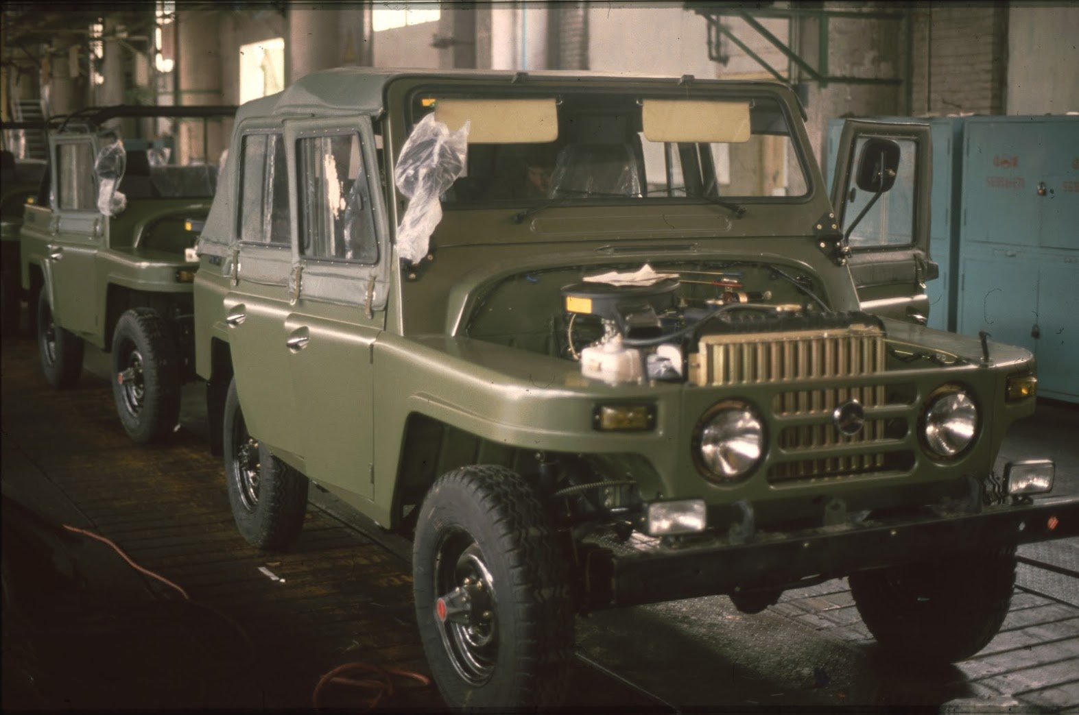

Slide 11
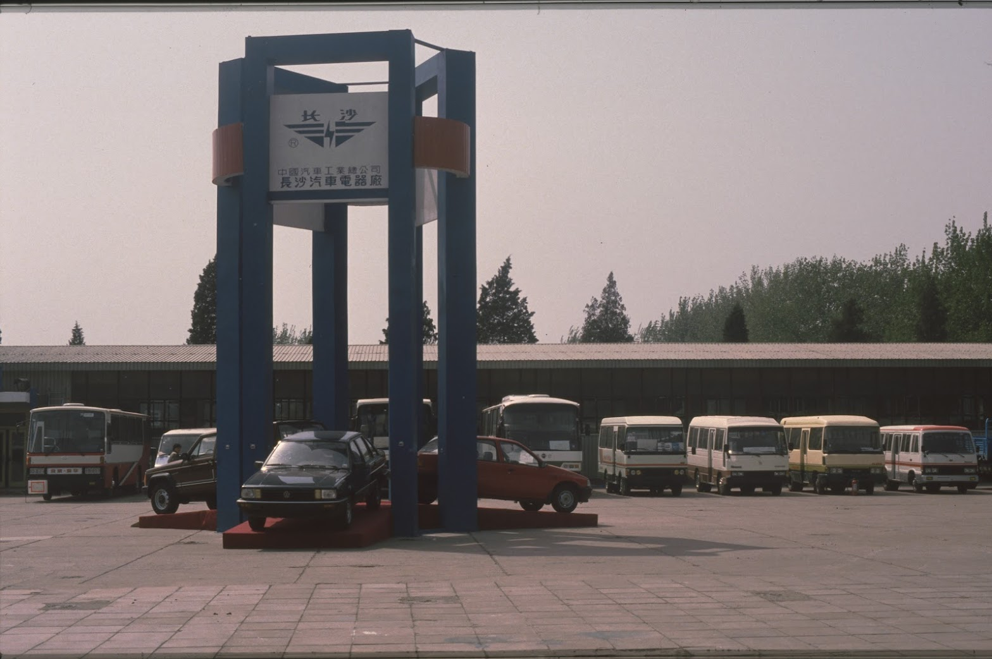
Car Fair Beijing 1989
Few private customers.
Marketing is only just developing.
Now: trade fairs are technology shows.
The world's most important auto shows are in China.

Slide 12
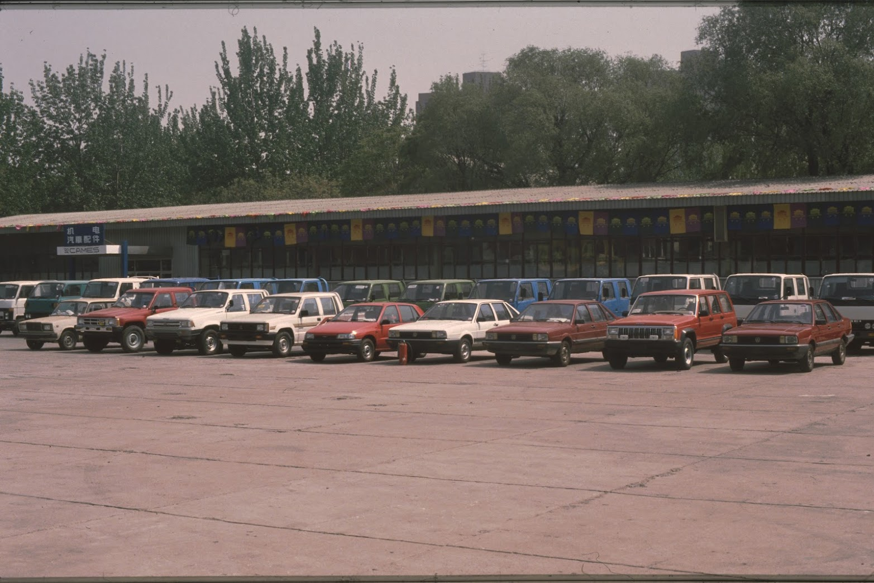
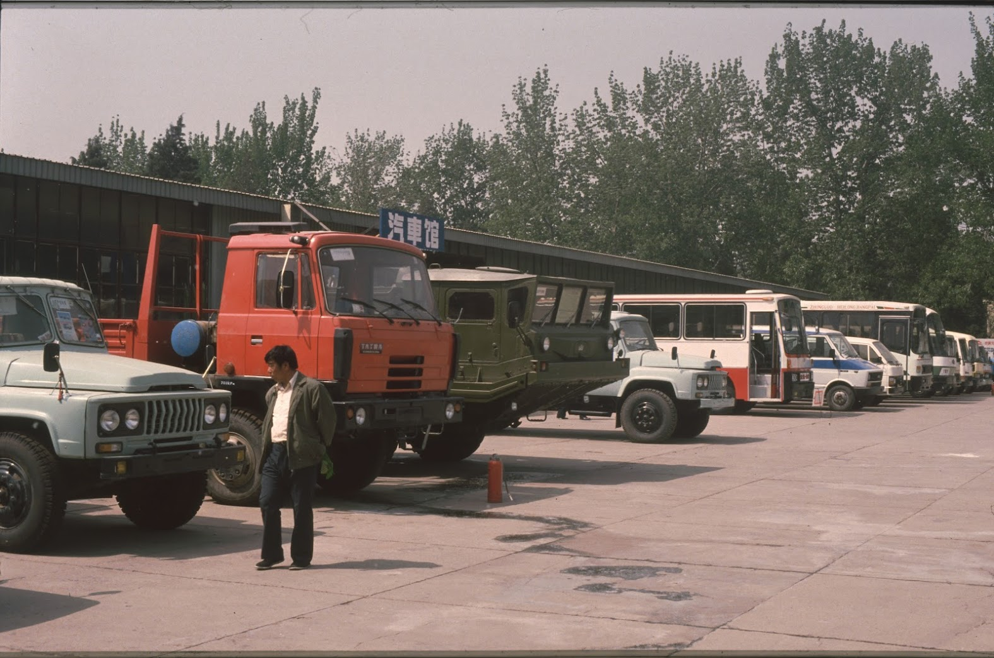
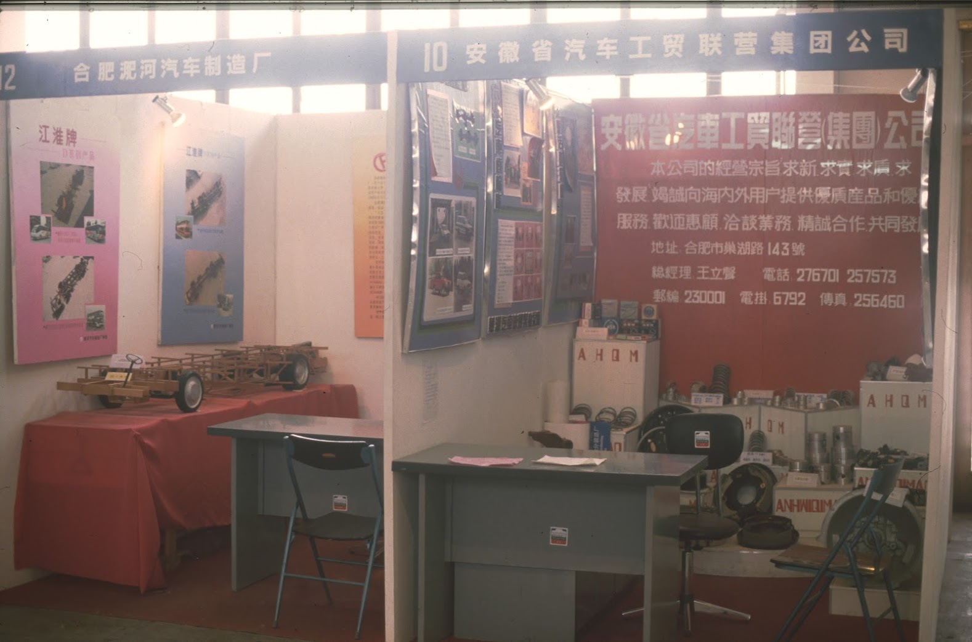
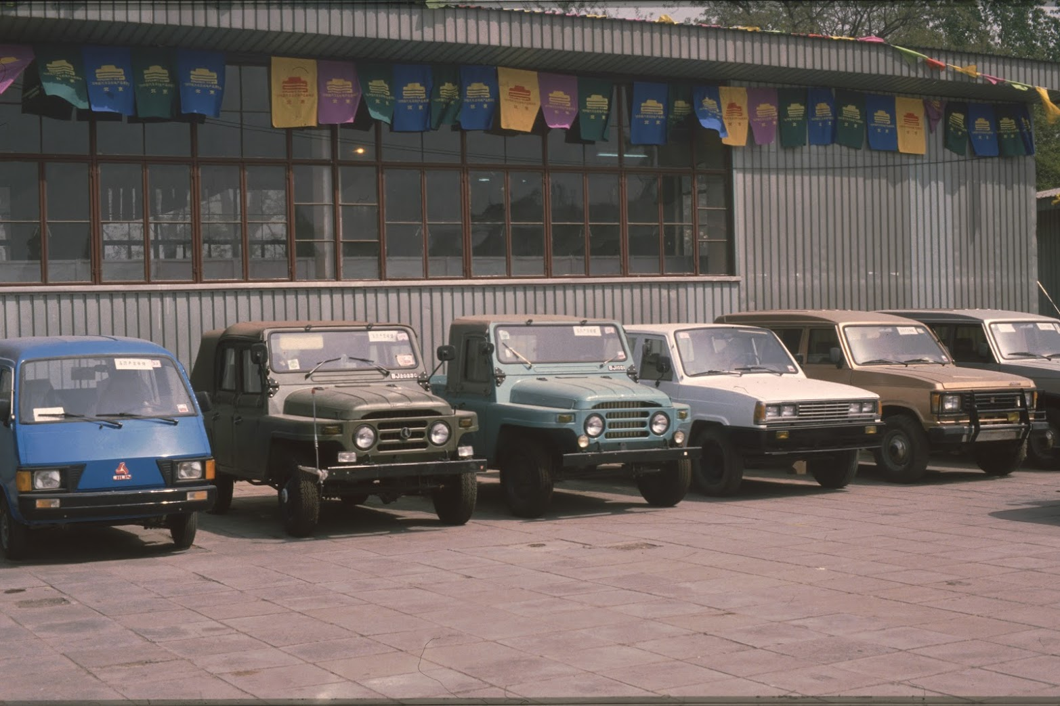

Slide 13
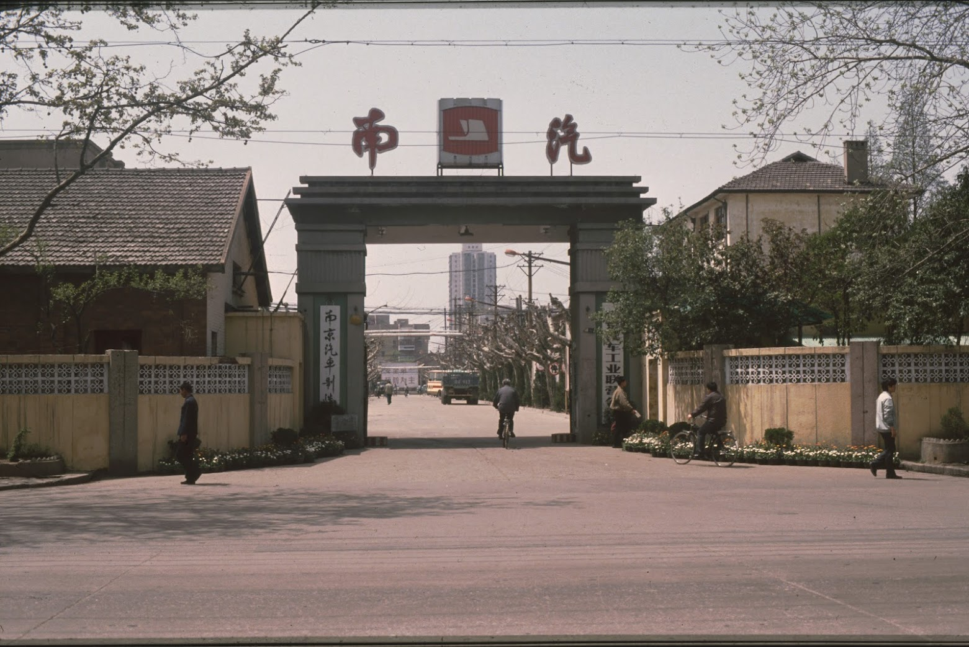
Nanjing Automobile 1988
Technology from Isuzu and the Italian company Iveco, Fiat's commercial vehicle division.
Acquired by SAIC in 2007.
Mergers, equity investments and acquisitions characterize the automotive industry.

Slide 14
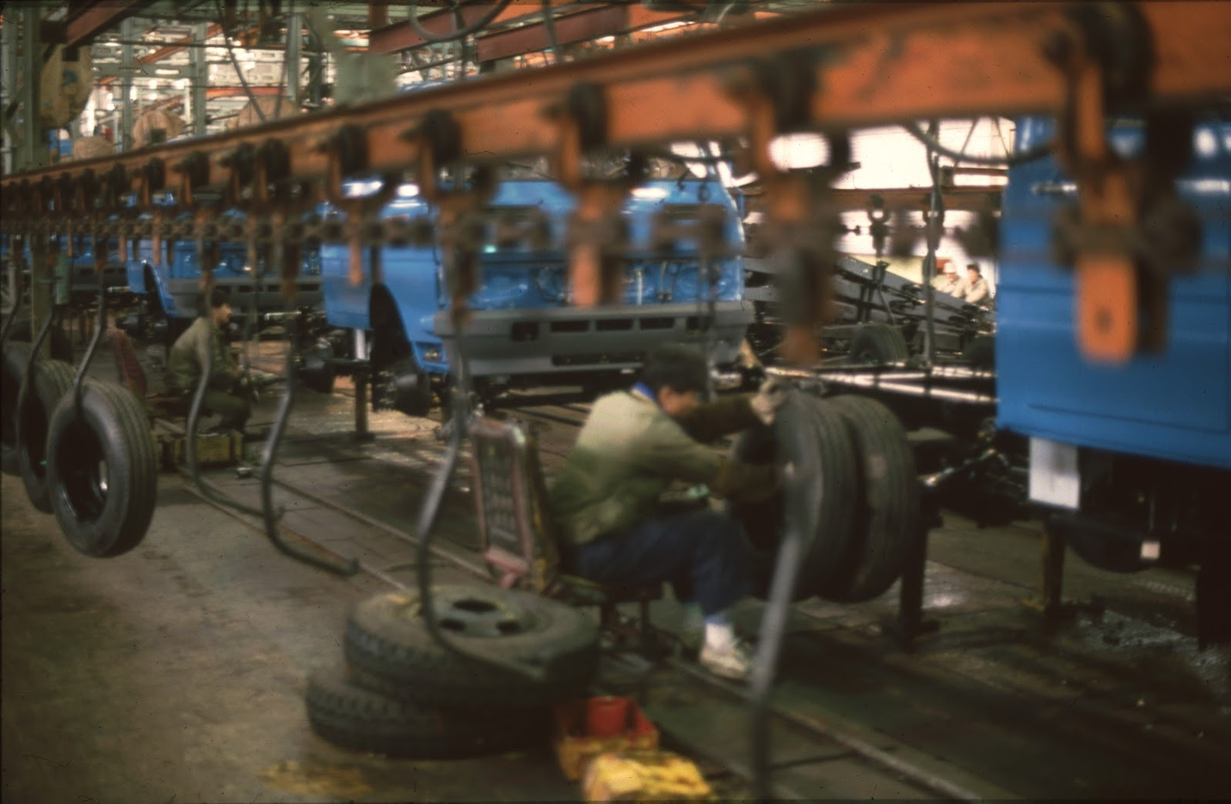
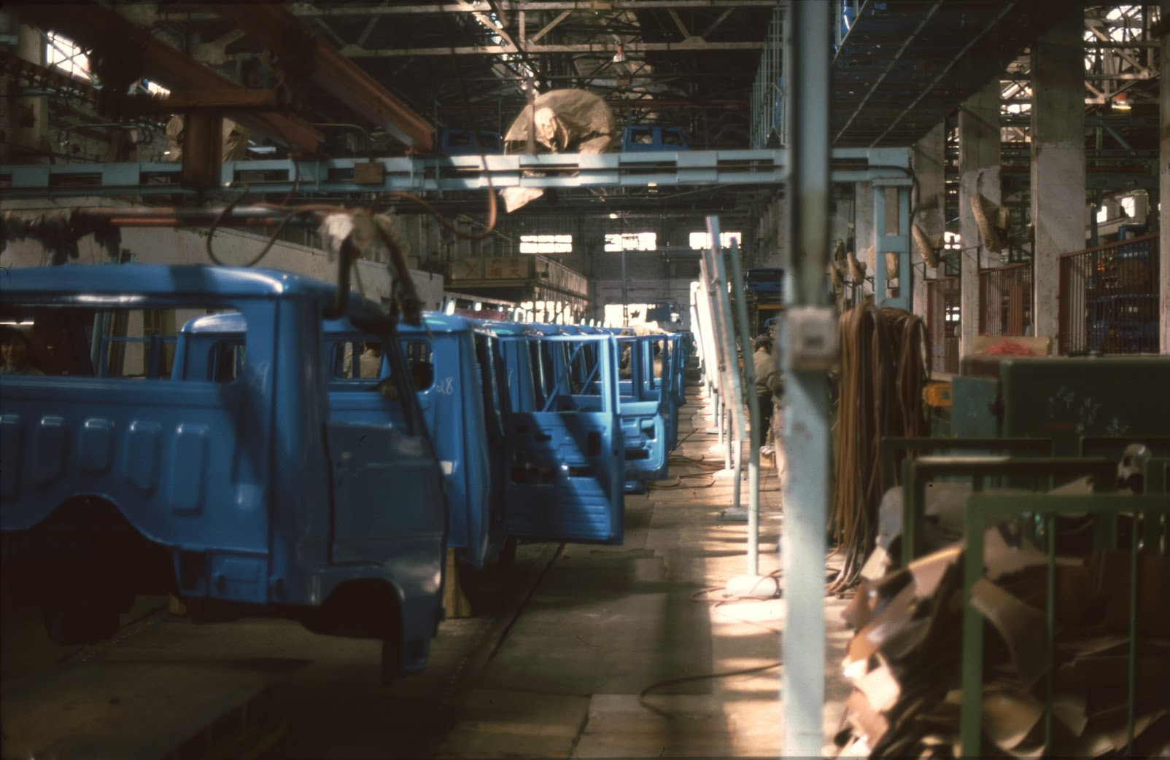
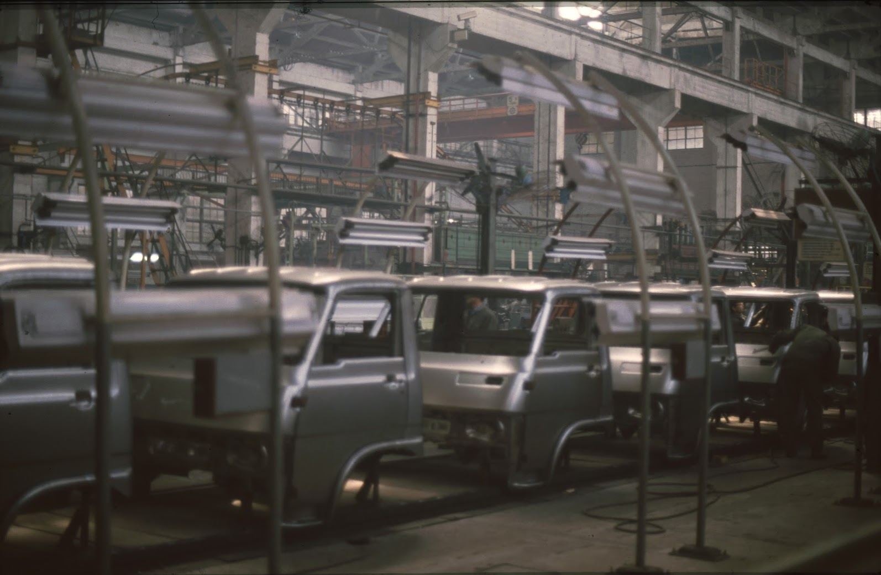
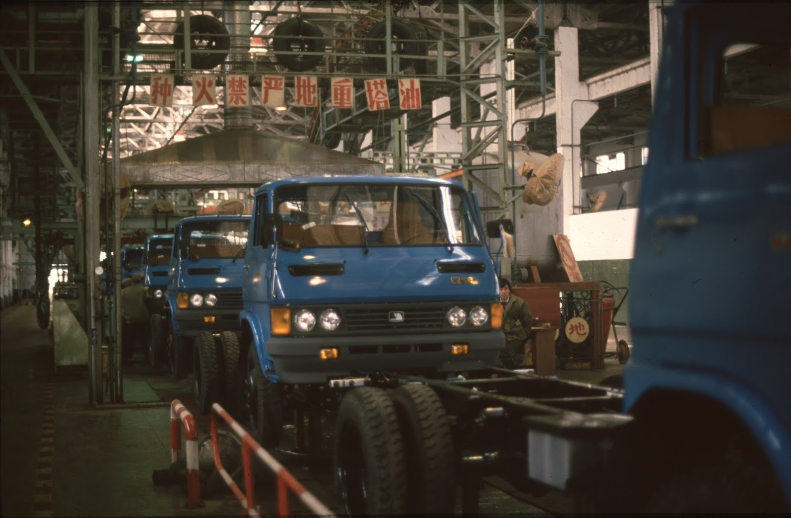

Slide 15
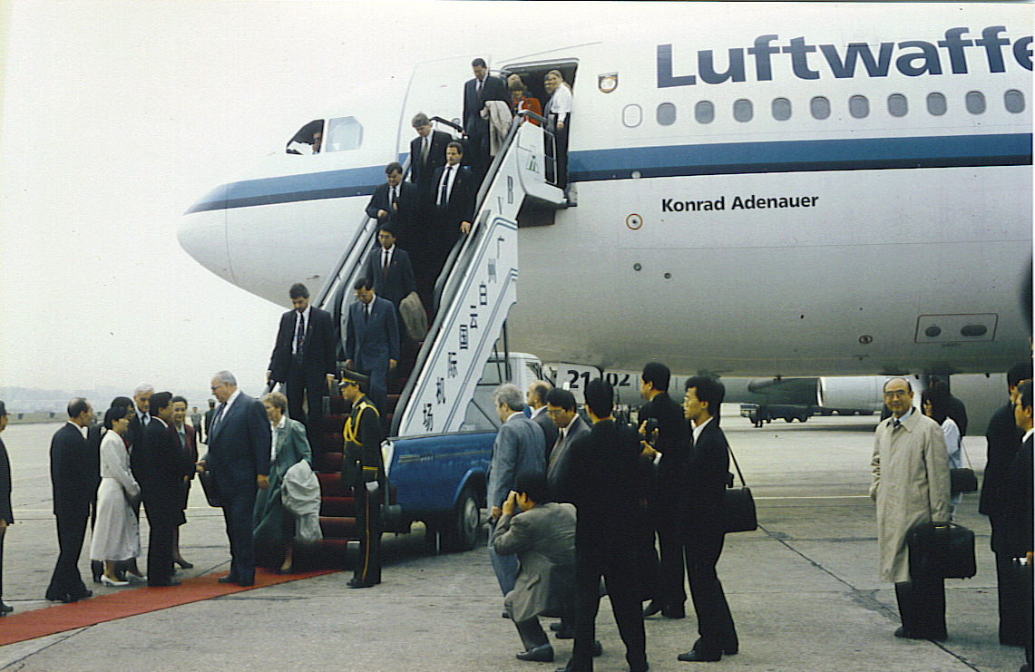
1993 Chancellor Helmut Kohl in China
156
156
Focus on economic, political, and cultural cooperation
Visit to Shanghai Volkswagen
Cooperation with Tongji University Shanghai

Slide 16
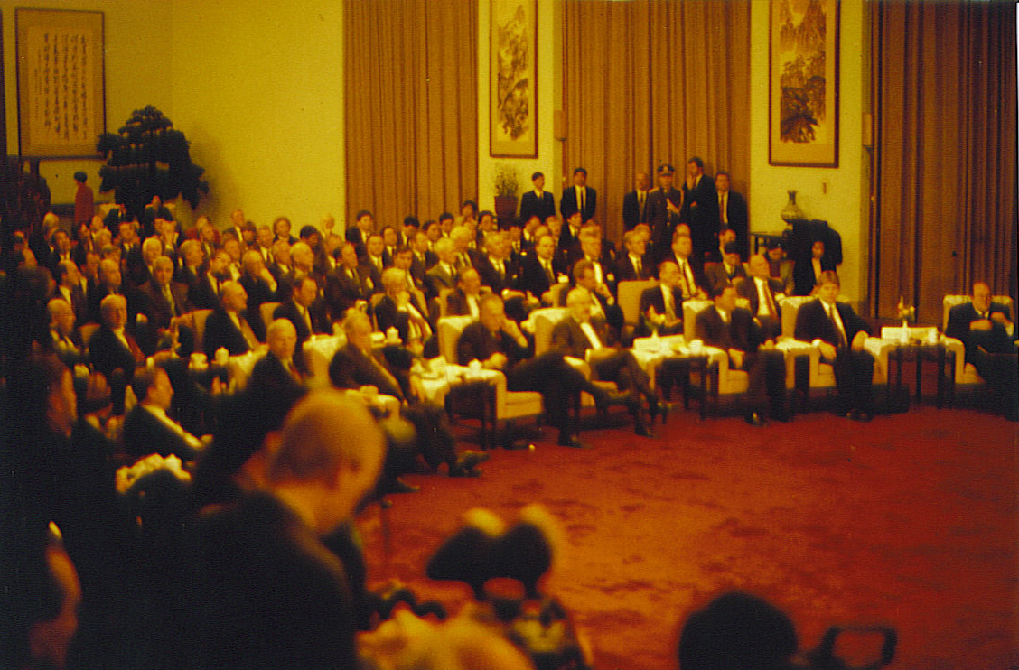
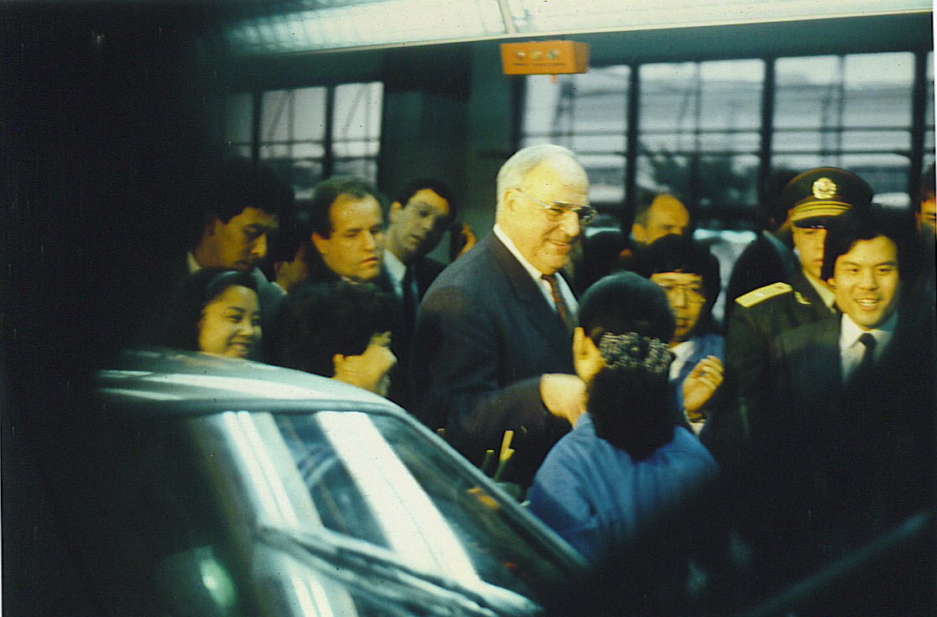
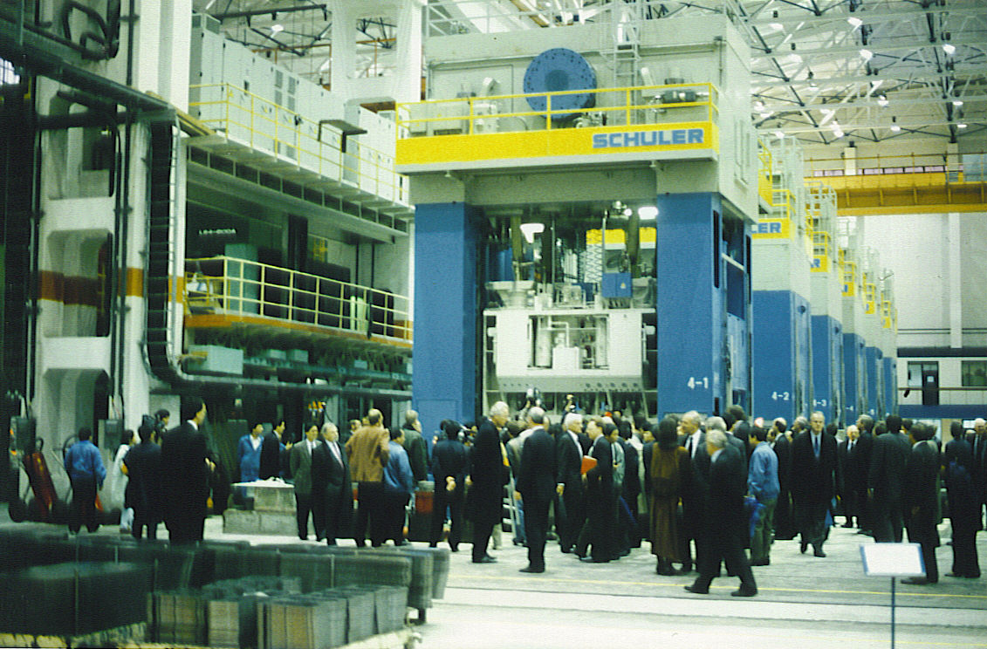
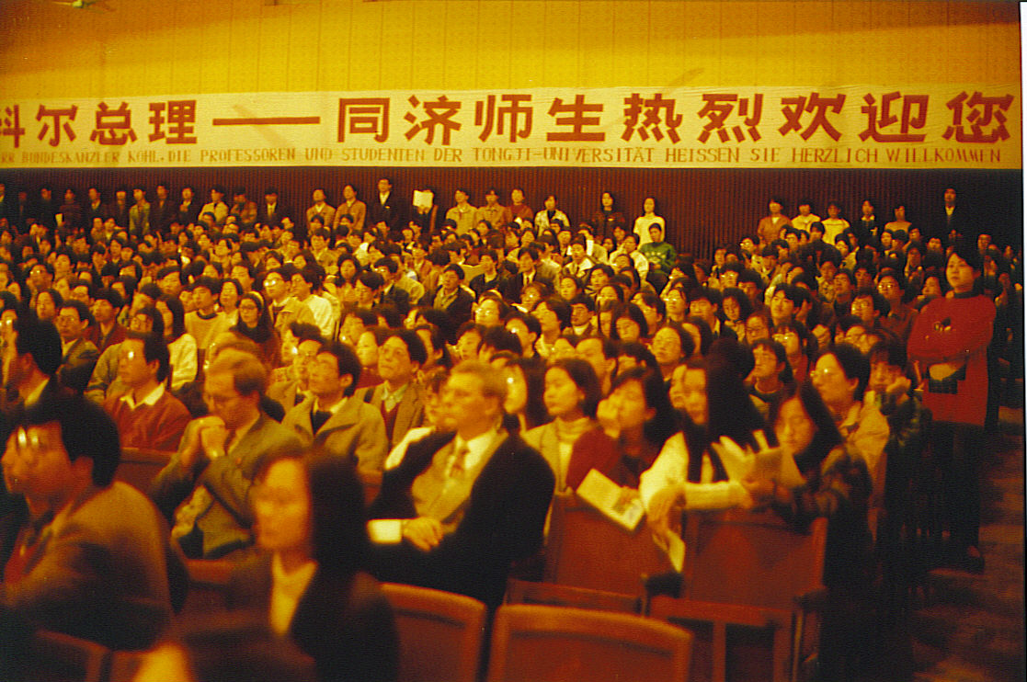

Slide 17
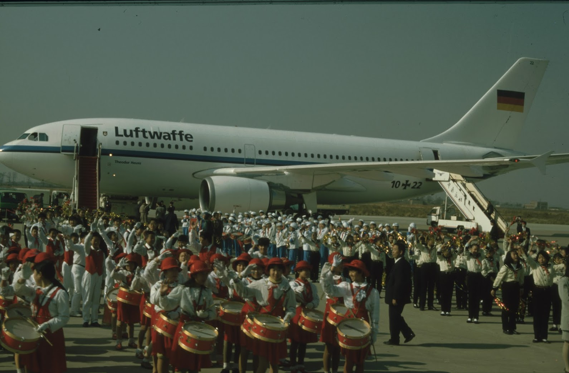
1995 Chancellor Helmut Kohl in China
Warm welcome.
Another large
business
delegation.
Numerous new
projects.

Slide 18
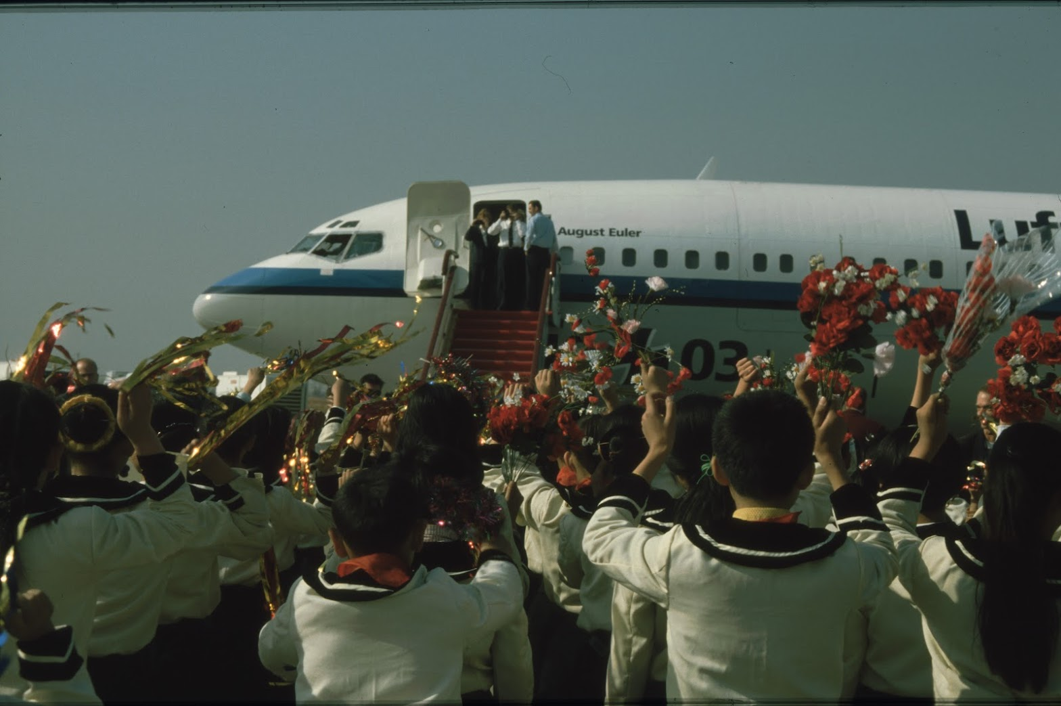
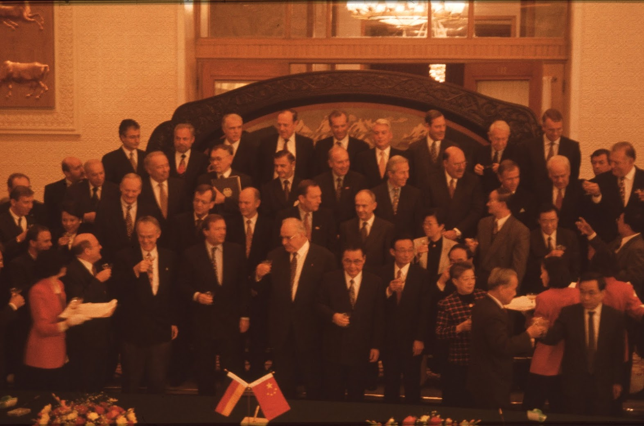
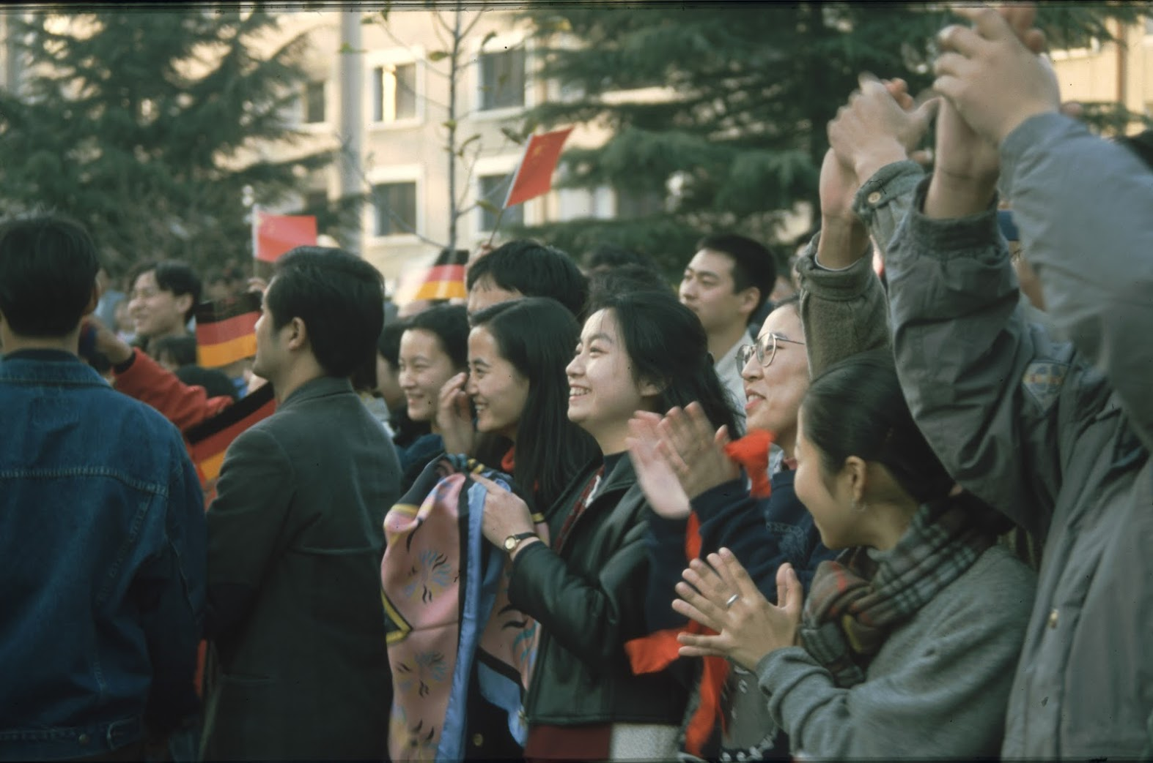
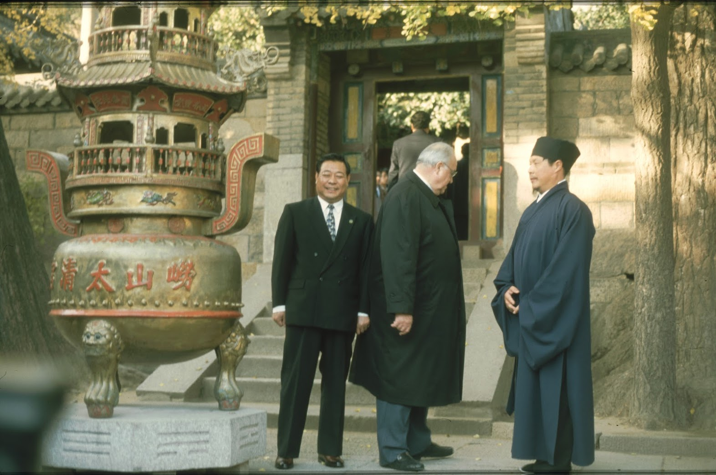

Slide 19
Time jump: China - Germany 2025
1990: China's nominal GDP was approximately US$360 billion.
2025: approximately US$20 trillion.
Growth more than 50-fold.
1990: Germany's GDP approx. €1,468.9 billion.
2025: approx. €4,470 billion.
Growth roughly threefold.
China overtakes Germany.

Slide 20
China: Poverty has been overcome
Car production is not an end in itself.
China has an integrated plan: prosperity, ecology, education and science, economic modernization.
Since the beginning of the reform and opening-up policy in 1978, China has lifted more than 850 million people out of extreme poverty.
Middle-class families can buy cars.
Increased prosperity is a prerequisite for successful environmental policy.
Cars are merely part of the transportation and infrastructure system.
What cars and modes of transportation will be available in China in 2050?

Slide 21
China: Technological Leadership
Research by the Australian Strategic Policy Institute (ASPI) shows that China is a leader in 57 out of 64 critical technology categories.
Historical shift:
Between 2003 and 2007, China was a leader in only three of the 64 technologies studied.
BYD employs more than 100,000 engineers and technicians in research and development.
Huawei employs more than 110,000 people in research and development, more than half of its workforce. 20% of its revenue is invested in research and development.

Slide 22
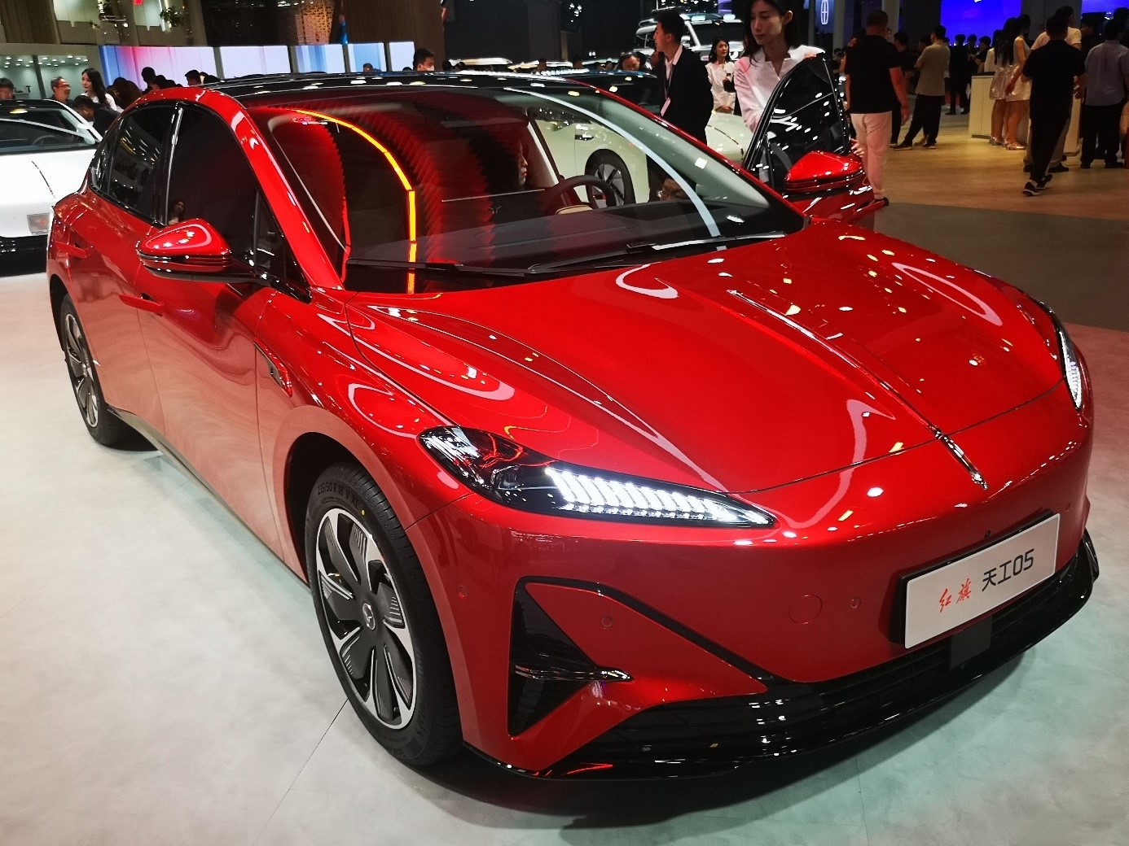
Redefining the car
"Smartphone on two wheels“.
Battery technology and electronics are key components of a car. Huawei is one of the largest and most innovative automotive suppliers. New founders come from the electronics industry.

Slide 23
„Made in Germany“ – „Made in China“
England was once a technology leader.
“Made in Germany” label to keep German "cheap products" from the English market.
The result: technological stagnation.
Great Britain barely has a car industry anymore.
The EU, and even more so the USA, are pursuing isolationist policies.
This is intended to distract from their own political failures.
Humanity has no future without international cooperation.

Slide 24
Germany, the world's leading exporter
German automotive industry export quota 70 percent.
China 2025
Car production 34.53 million vehicle Sales 34.4 million.
China still balanced.
But due to its high production capacity, China could produce more than the world market can handle.
Tesla Shanghai has the highest export quota.
BYD's overseas sales in March reached 40 percent.
BYD sales in Germany increased by 600 percent.

Slide 25
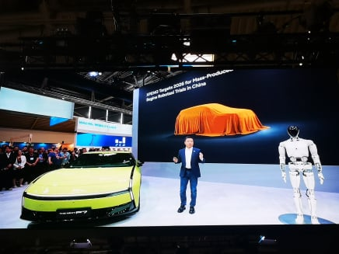
China overtakes EU in car exports
Exports of cars and car parts from the EU to China fell by 34 percent last year to € 16 billion.
Since 2022, exports have thus more than halved.
At the same time, imports from China in this sector rose by eight percent to € 22 billion.
A trade surplus in the tens of billions has therefore turned into a deficit within just a few years.

Slide 26
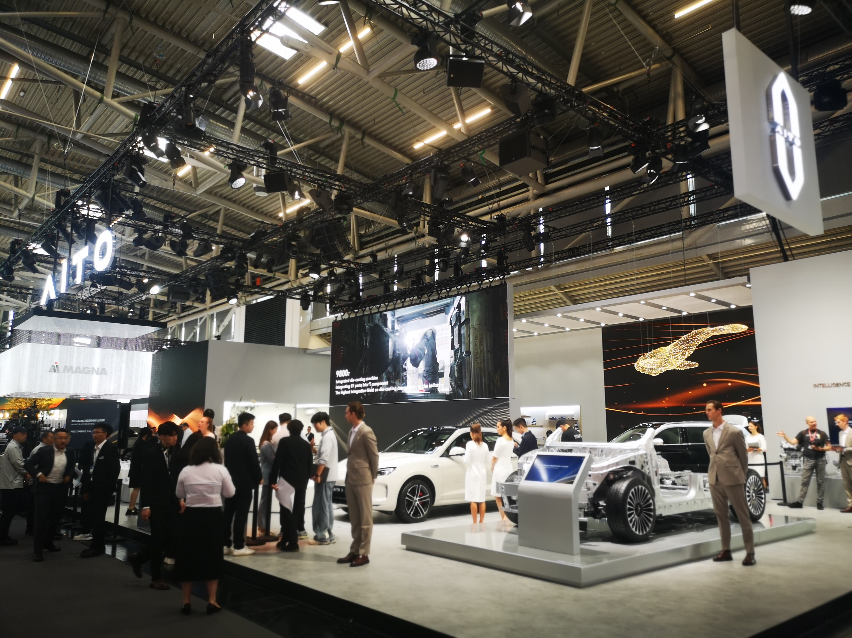
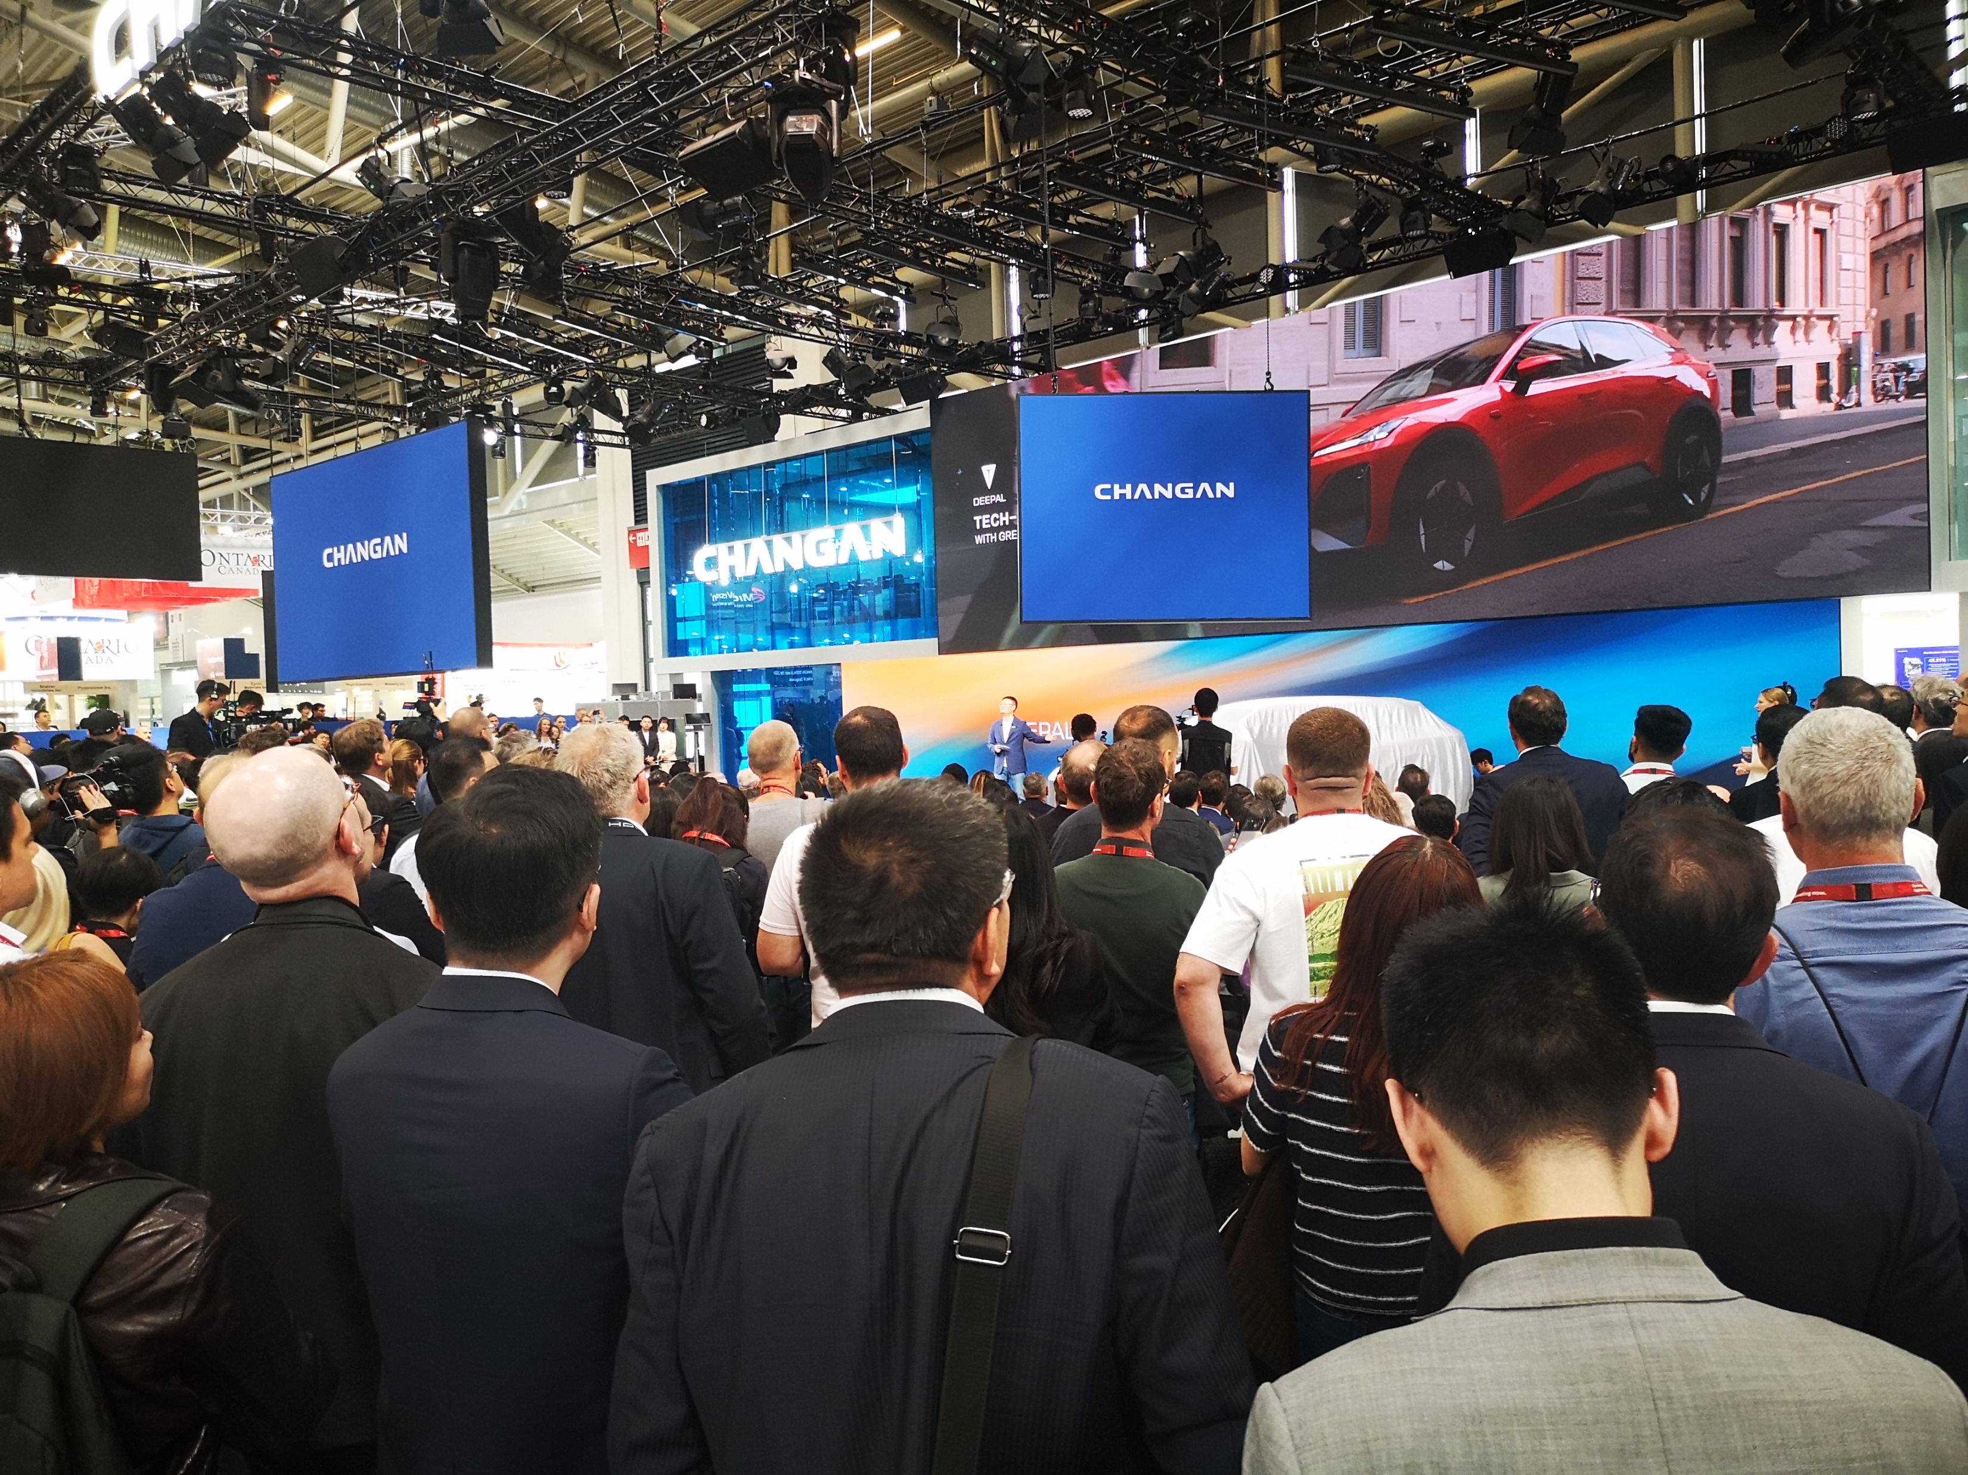
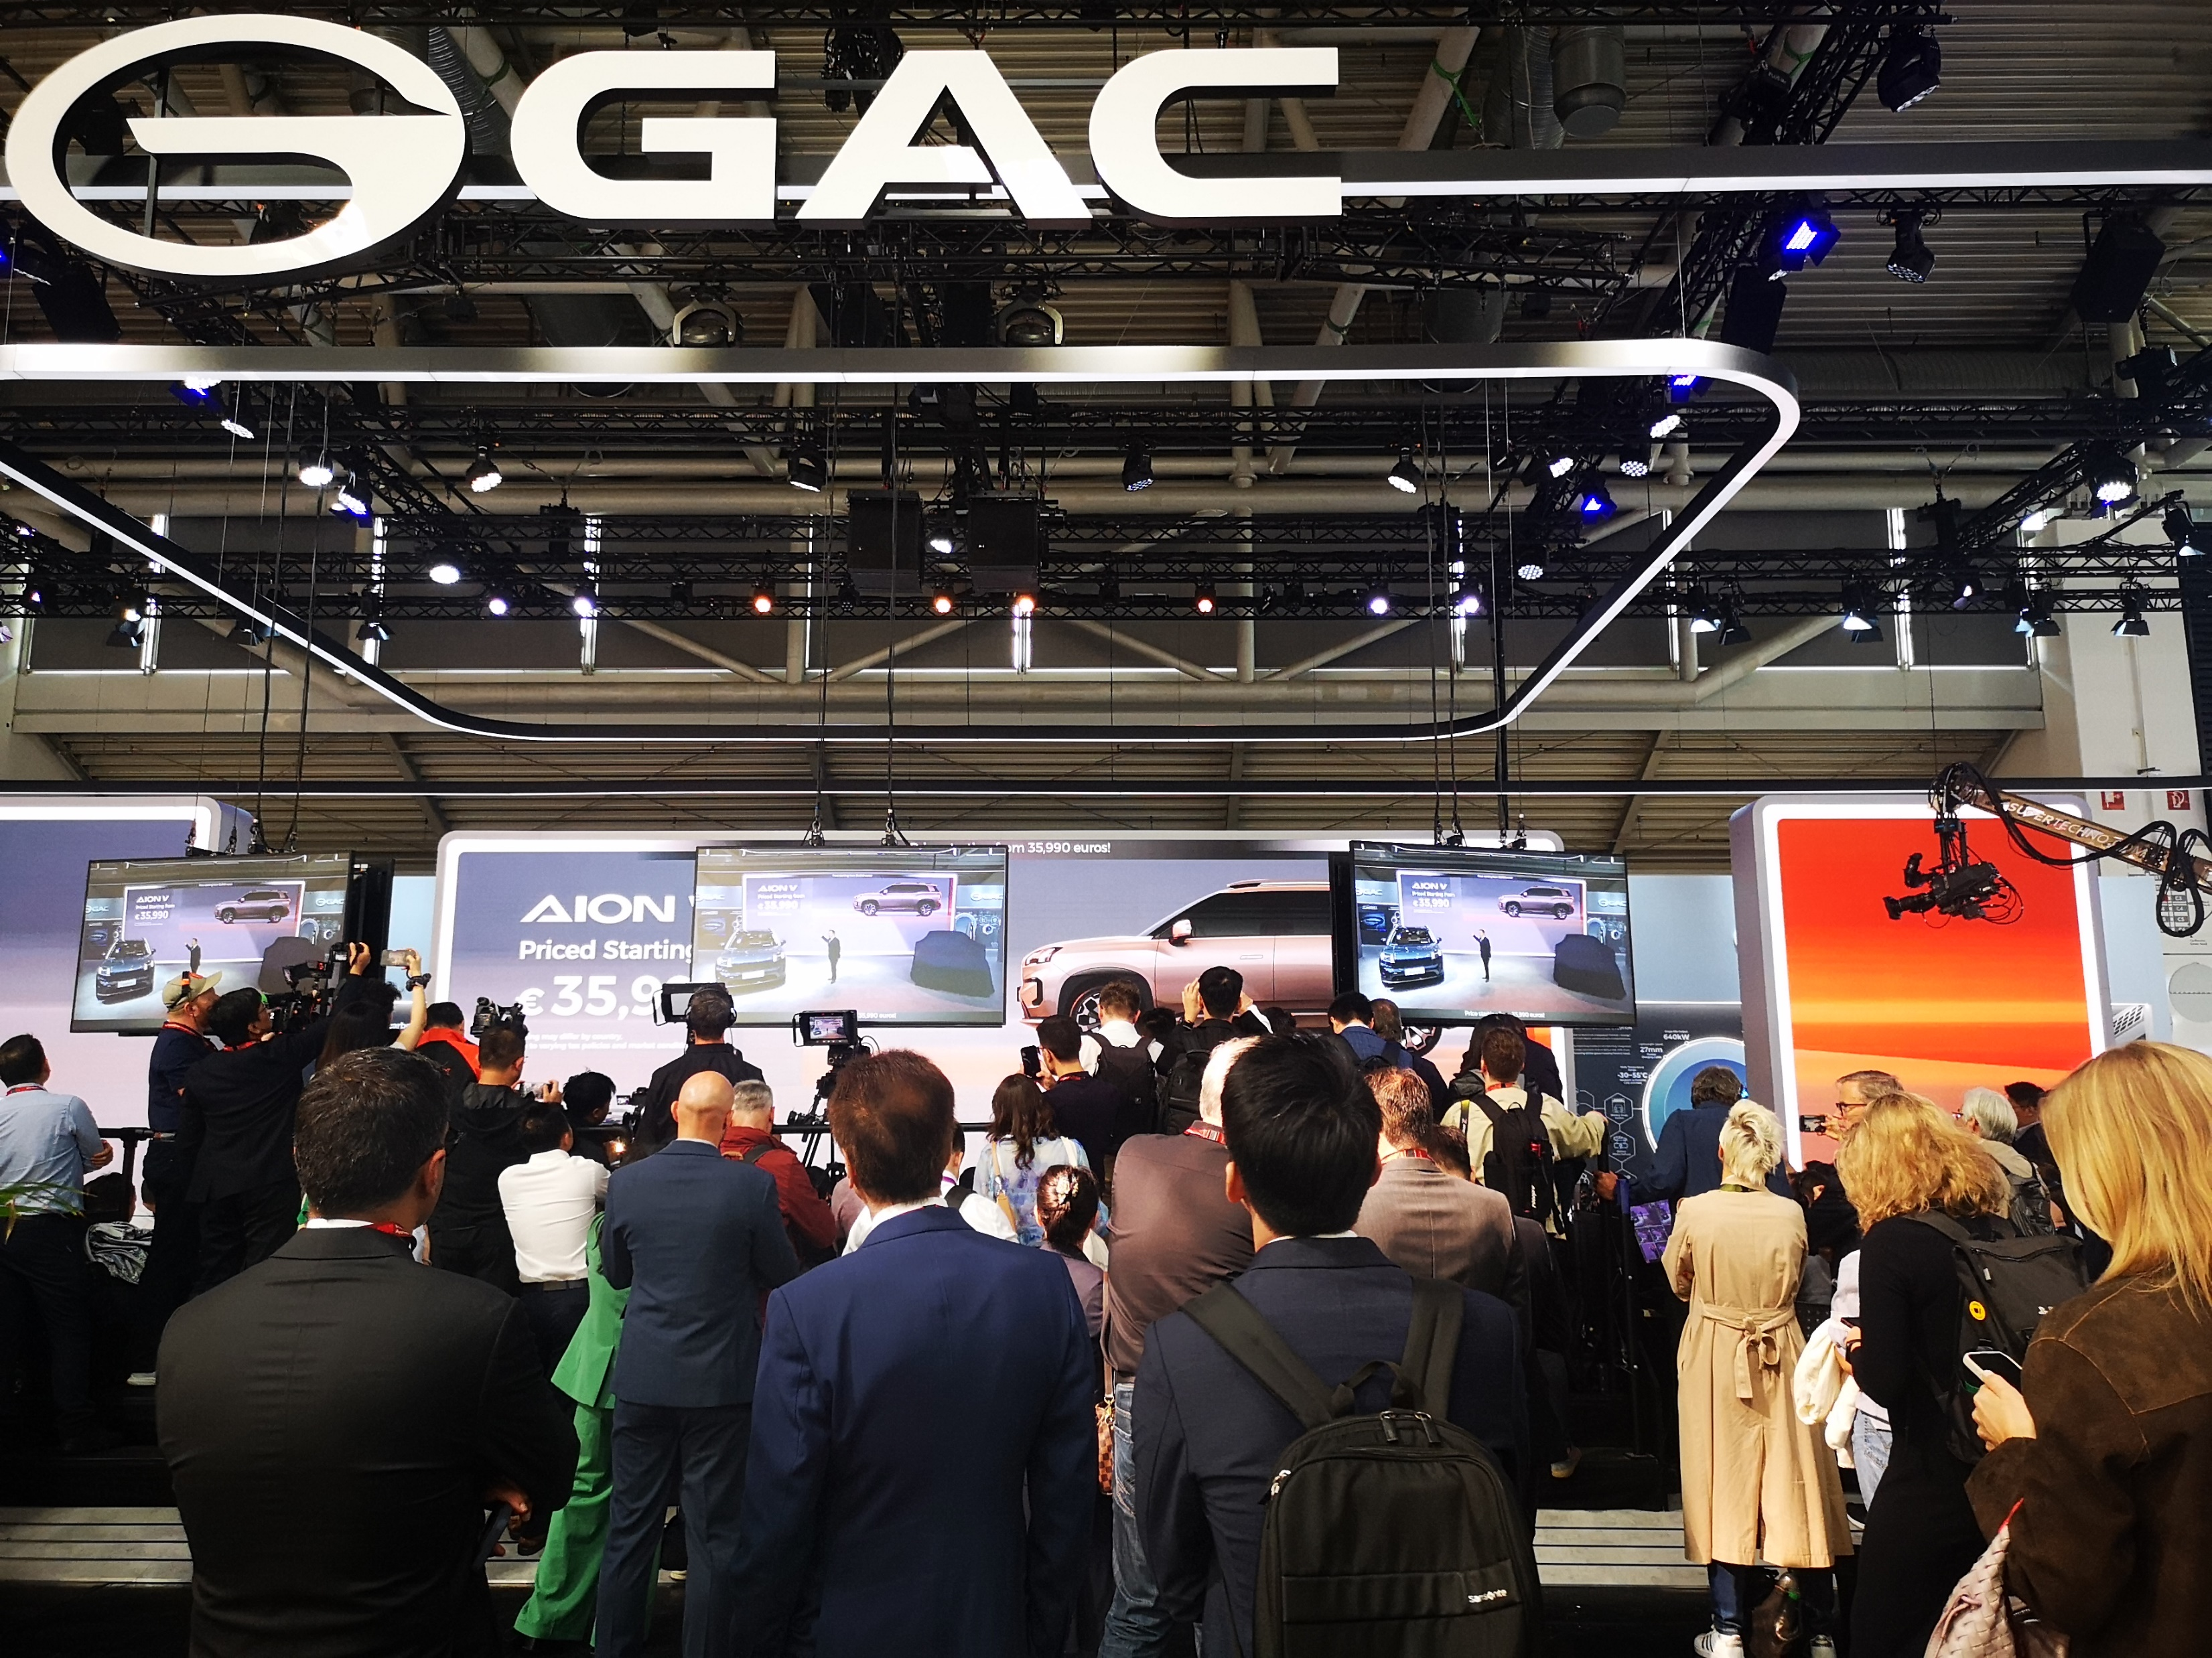
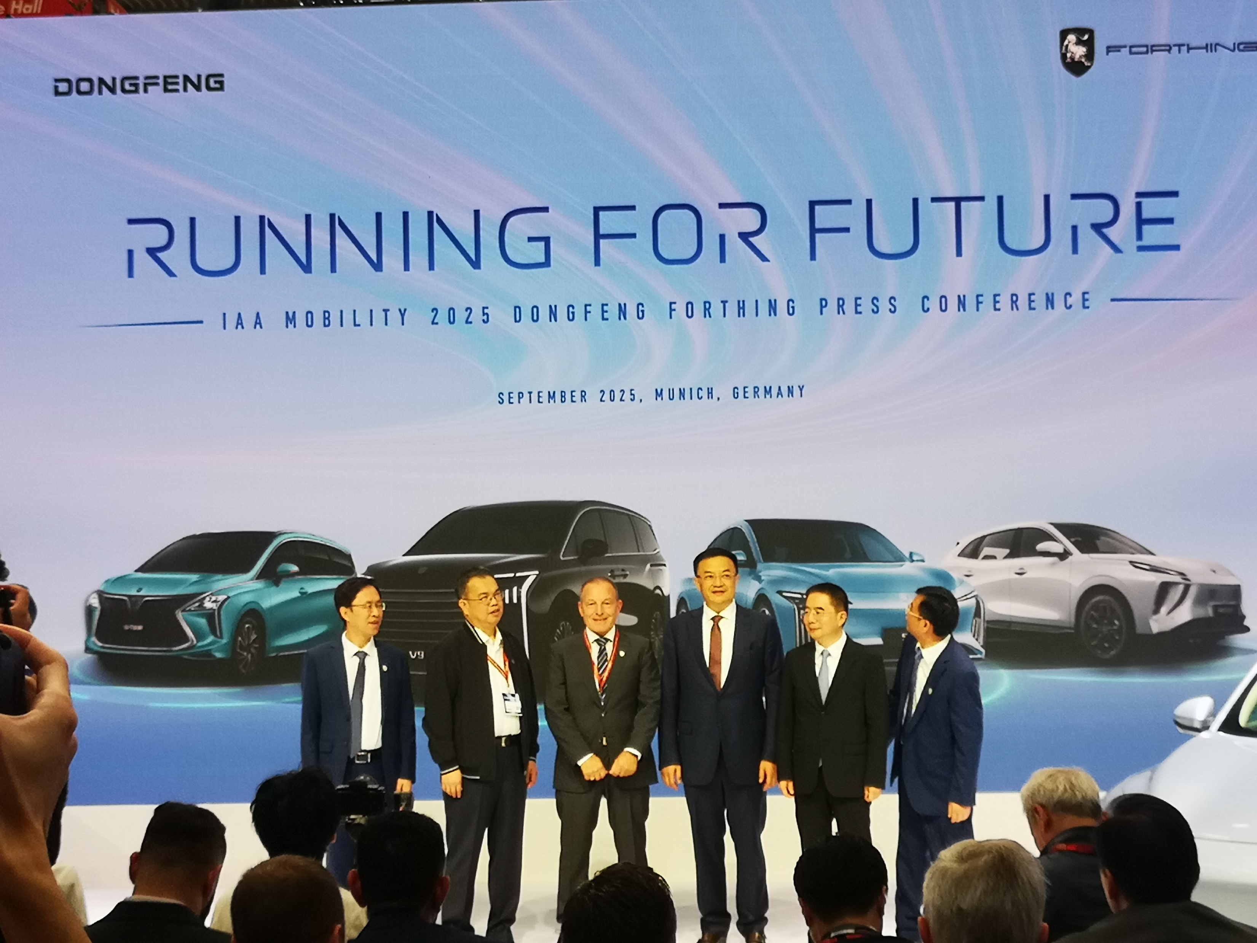
Chinese companies at the IAA Munich motor show 2025

Slide 27
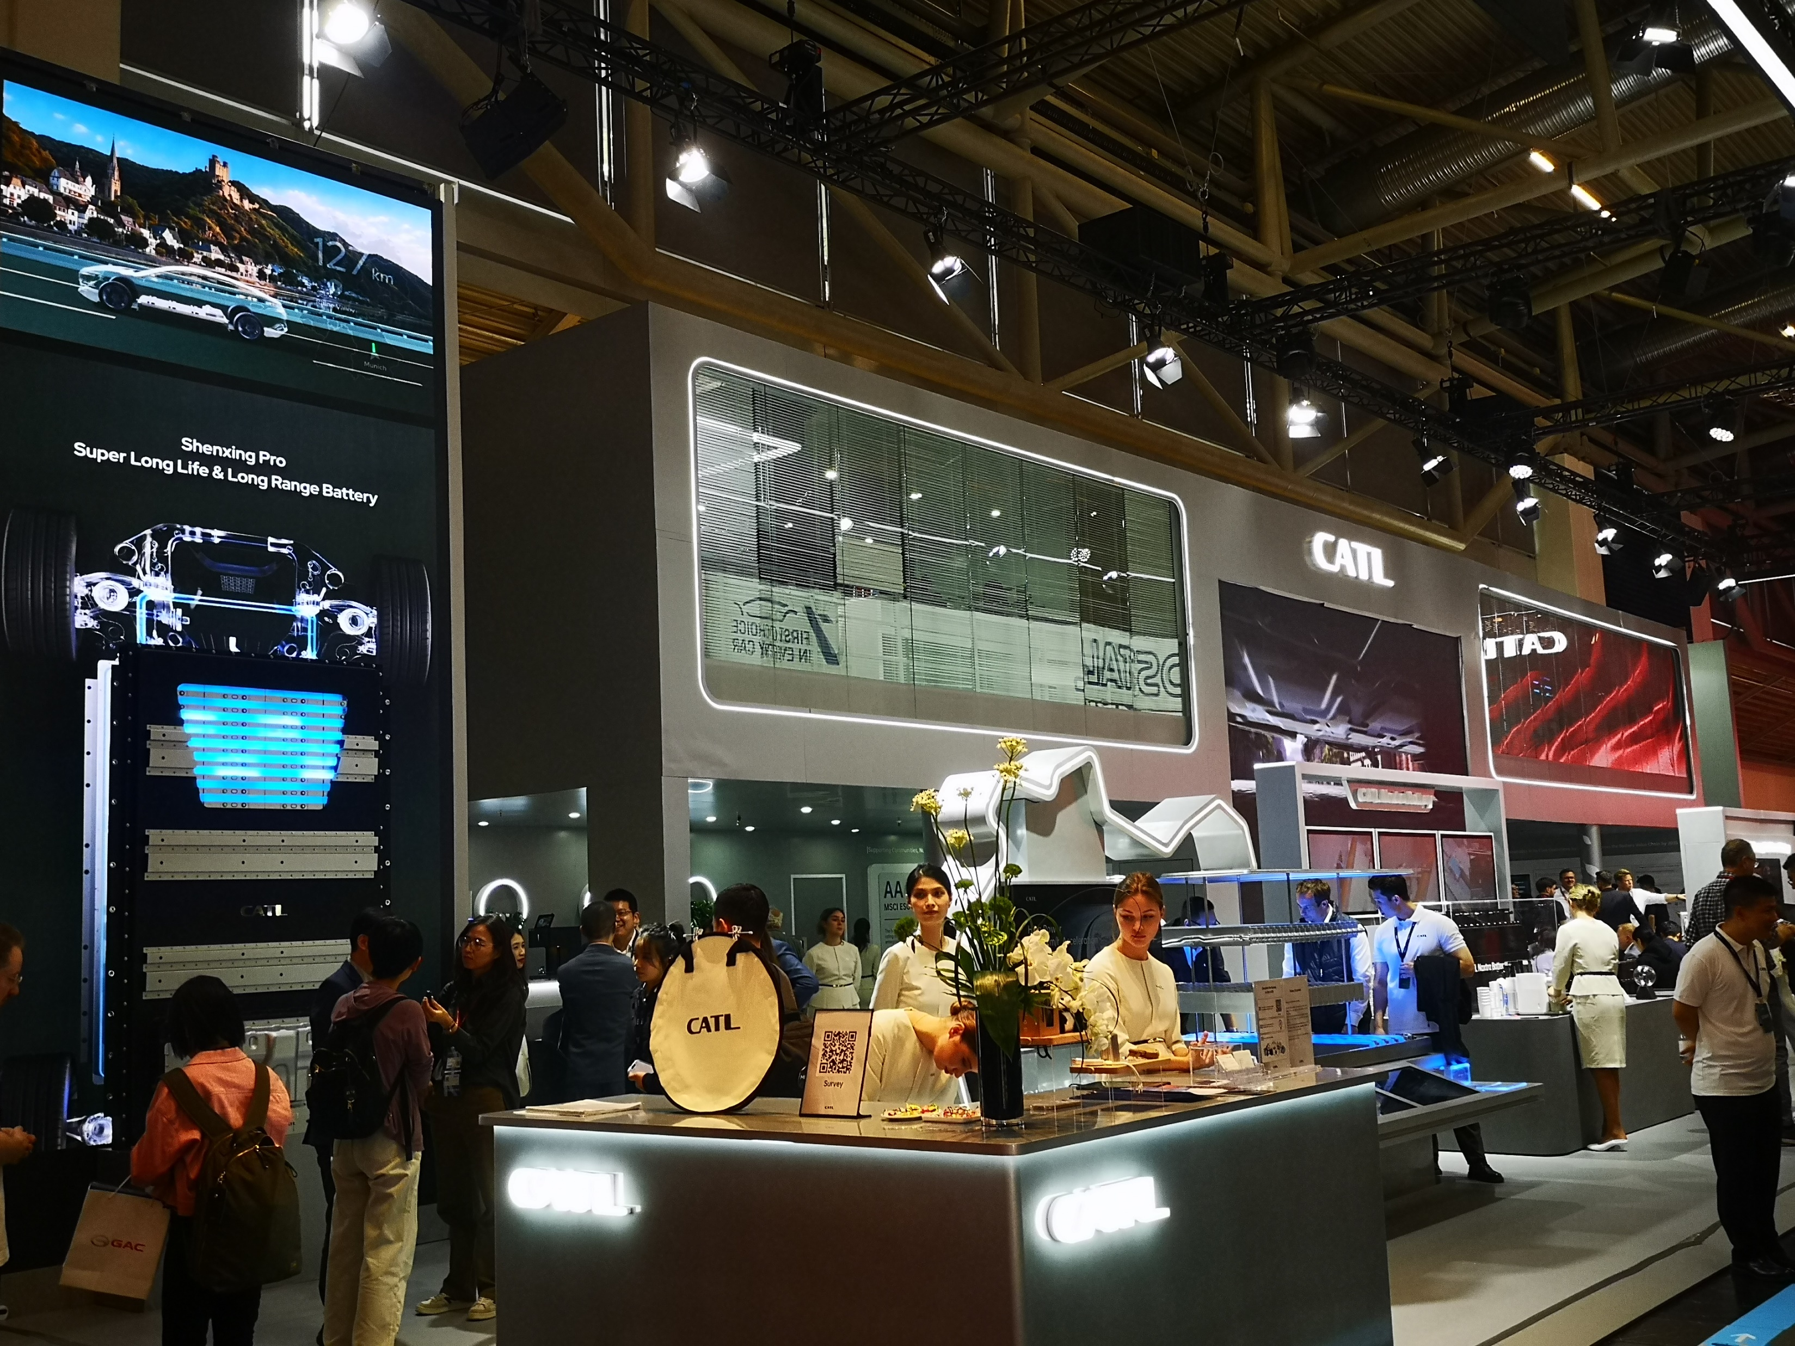
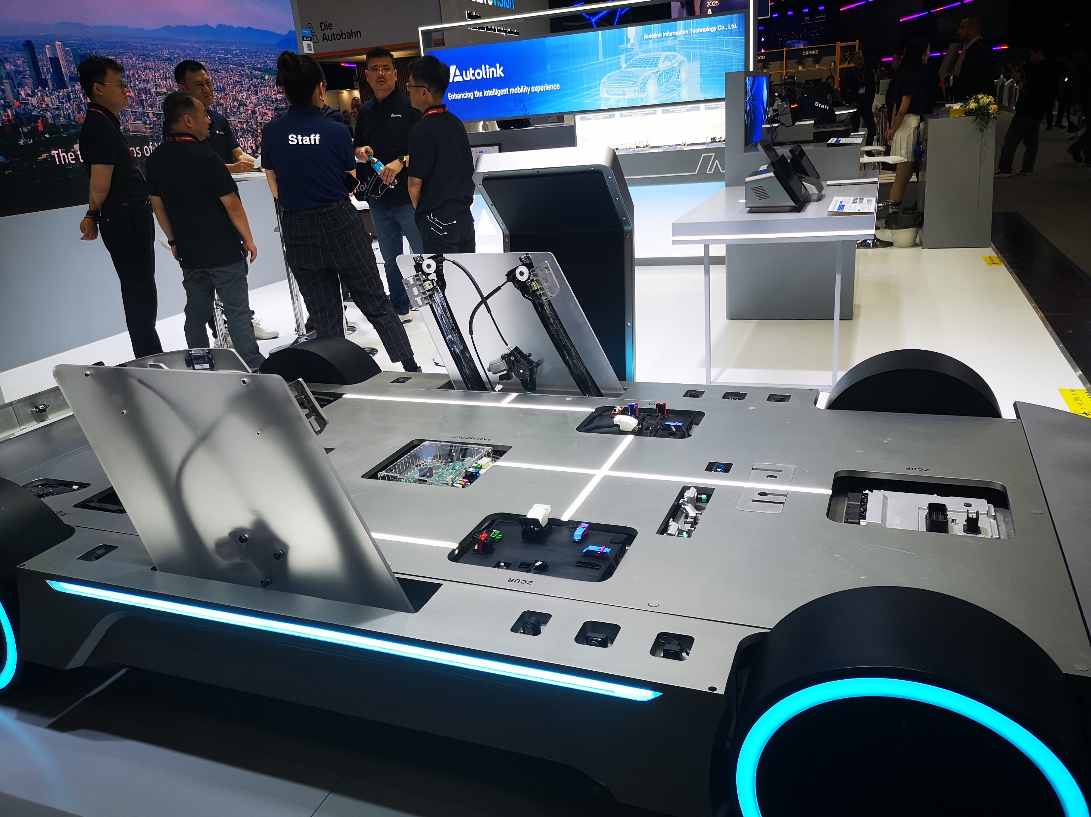

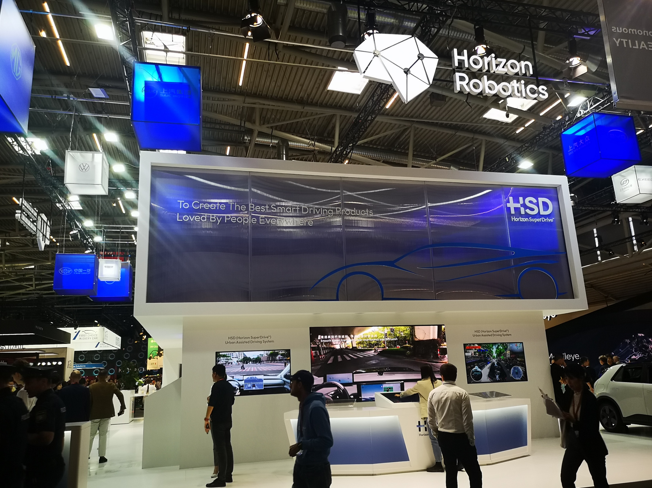
Chinese companies at the IAA Munich motor show 2025

Slide 28
Local production required
Closed markets hinder innovation and price reductions.
However, persistently large exports destroy industry and markets.
Solution: local investment and production.
The EU, and even more so the US, are hindering investment.
A win-win situation must be created.
Fewer regulations and prohibitions, but more incentives.
The EU should look at the Chinese modernization concept and learn from it.
Not adopt it, but integrate it into its own concept.

Slide 29
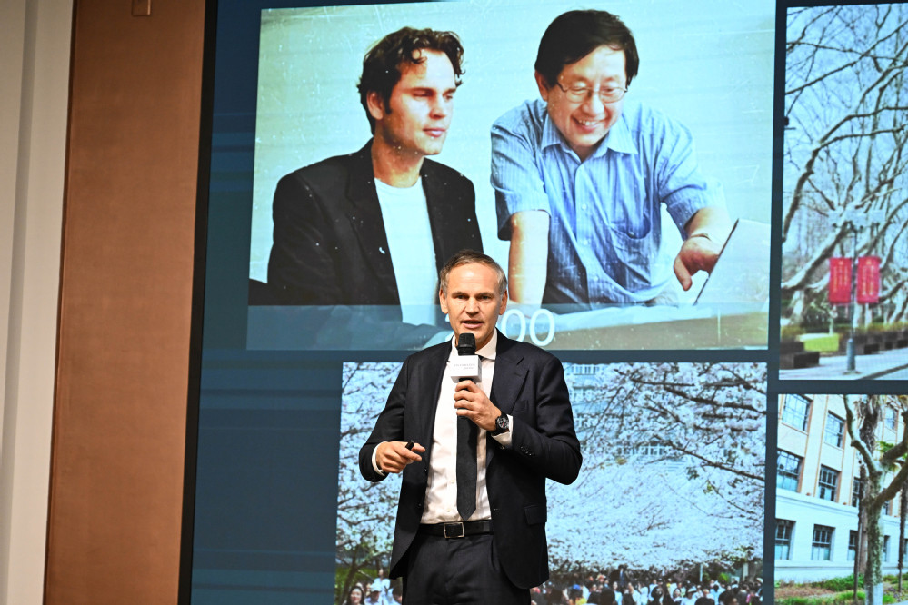
Car companies rely on cooperation
Volkswagen CEO Oliver Blume: In China for China – Learning from China's Industrial Plans.
Blume earned his doctorate at Tongji University under Wan Gang.
Mercedes CEO Ola Källenius:
“In China for China”.
BMW CIO Franz Decker:
Learning pragmatism from China.
Gernot Döllner, Chairman of the Board of Management of AUDI AG: China is the benchmark for innovation.

Slide 30


